Slide 1
Background to the Civil Rights Movement

Slide 2
Emancipation Proclamation
Issued by President Abraham Lincoln on January 1, 1863
Proclaimed freedom to all slaves that lived in rebellion states (3.1 million slaves)
Became a wartime goal, but did not give slaves citizenship nor outlaw slavery entirely.

Slide 3
After reading through the excerpt from the Emancipation Proclamation, what do you think this decree affected the Civil Rights Movement?
"And by virtue of the power, and for the purpose aforesaid, I do order and declare that all persons held as slaves within said designated States, and parts of States, are, and henceforward shall be free; and that the Executive government of the United States, including the military and naval authorities thereof, will recognize and maintain the freedom of said persons. "

Slide 4
Reconstruction Amendments
Amendments passed during the years directly following the Civil War
These amendments were to help unify the nation together, guarantee freedom and prevent discrimination for all people, including former slaves.

Slide 5
Read through each of the Reconstruction Amendments, summarize the amendments in your notes.

Slide 6
Reconstruction Amendments

Slide 7
End of Reconstruction
In 1877, Rutherford B. Hayes became President and ended Reconstruction
Now there was no one to enforce the new laws/amendments; no one to punish those who treated blacks unfairly
People worked to undermine efforts of equality
Black codes and Jim Crow laws created legal forms of segregation

Slide 8
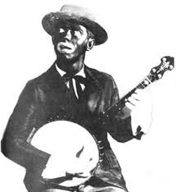
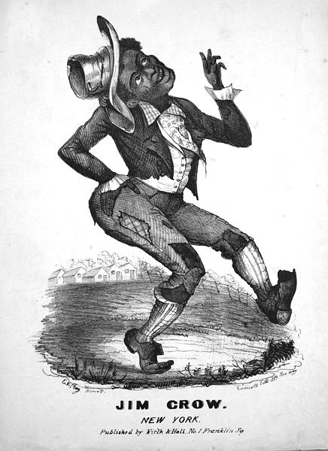
Who was Jim Crow?
Daddy Rice
White actor
Covered his face with charcoal and then sing and dance in a silly way
Characters name was Jim Crow
People began to use Jim Crow as a way to describe Black People
https://www.youtube.com/watch?v=ALTam2L9NhE

Slide 9
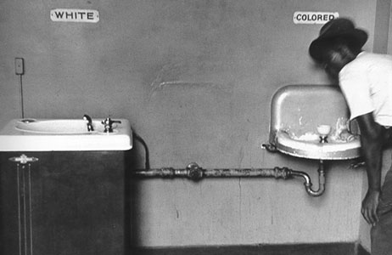
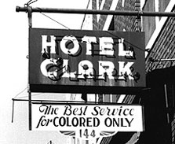
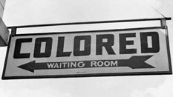
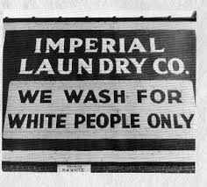
Examples
Jim Crow Laws were found all over the South (and even in many Northern states)
Limits on who people could marry, adopt, or where they could attend school
Segregation of public accommodations as well

Slide 10
Define Black?
Jim Crow laws were based on the difference between whites and blacks
Considered black if you had only one great grandparent who was black (1/8 African heritage)
If there was doubt, a person would have to prove heritage - 3 generations back
Great Grands
Grand Parents
Parents
YOU

Slide 11
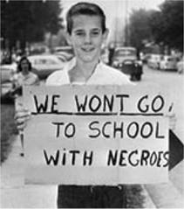
Jim Crow Laws
Education
Marriage and Family
Public schools provided for black children
Lacked books, supplies and other resources
One law said blacks and whites couldn’t use the same textbooks
Another law said bus drivers had to be the same race as the students they drove around
Miscegenation: mixing of races
Northern and Southern states had a variety of laws that banned marriages and relationships between blacks and whites
Interracial adoptions banned

Slide 12
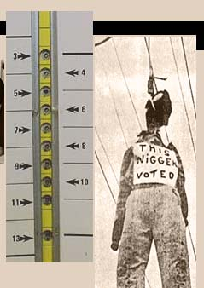
Jim Crow Laws
Transportation:
Voting Rights:
Blacks required to sit in the back of public buses and train cars
Sometimes they were forced to sit in separate cars altogether
Laws that restricted African American’s right to vote
Even when blacks did vote, many of their ballots were stolen or not counted
KKK intimidated black voters

Slide 13
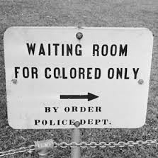
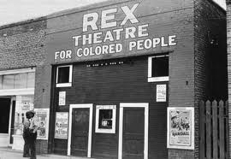
Jim Crow Laws
Public Accommodation:
Anything from a restaurant to a prison to a hotel
Laws were written to keep races separate, especially in public spaces
Signs posted to designate which area was for which race
Examples: Separate entrances, drinking fountains, libraries, etc

Slide 14
ACTIVITY
You will be shown primary source documents from the Jim Crow era and need to determine which rights are restricted in each document. Circle the correct category in your notes. Also, place a star next to the document that shocked you most.

Slide 15
Poll Tax Receipt
Louisiana 1918
DOCUMENT 1

Slide 16
Rex Theatre
Mississippi 1939
DOCUMENT 2

Slide 17
Virginia state Law
“…no athletic team of any school shall engage in any athletic contest of any nature within the state of Virginia with another team on which persons of any other race are members.”
1960
DOCUMENT 3

Slide 18
Entrance sign
Alabama 1931
DOCUMENT 4

Slide 19
Tennessee Law
“White and colored persons shall not be taught in the same school, but in separate schools under the same general regulations as to management, usefulness and efficiency.”
1873
DOCUMENT 5

Slide 20
segregated bus
Florida 1950s
DOCUMENT 6

Slide 21
Missouri state law
“Interracial adoptions are forbidden by law.”
1952
DOCUMENT 7

Slide 22
Mississippi state law
“Businesses are allowed to choose their customers and have the right to refuse service to any person.”
1956
DOCUMENT 8

Slide 23
Alabama constitution
Declared that the legislature could never pass any law allowing “any marriage between any white person and a Negro, or descendant of a Negro.”
1901
DOCUMENT 9

Slide 24
bus station
Texas 1952
Document 10

Slide 25
Plessy v. Ferguson
FACTS OF THE CASE
State of Louisiana enacted a law that required separate railway cars for blacks and whites
In 1892, Homer Adolph Plessy—who was seven-eighths Caucasian—took a seat in a “whites only” car of a Louisiana train.
He refused to move to the car reserved for blacks and was arrested.
QUESTION
Is Louisiana’s law mandating racial segregation on its trains an unconstitutional infringement on both the privileges and immunities and the equal protection clauses of the 14th Amendment?

Slide 26
ACTIVITY
Put the facts of the case in the right order on your paper.

Slide 27
Facts of the Case
Plessy appealed the decision and lost again, but took the case to the Supreme Court in 1896.
B. Homer Plessy bought a first class train ticket and sat down in the ‘white only’ section of the train.
C. The Supreme Court upheld the previous decisions and said that racial segregation was constitutional if accommodations were equal. This led to more and more legal segregation all over the US.
D. Plessy was arrested for riding in a ‘whites only’ railroad car, because he was 1/8th black.
E. Plessy argued that the Act violated his 13th & 14th Amendment rights, but he lost in the local court.

Slide 28
Plessy v. Ferguson
CONCLUSION
7 votes for Ferguson, 1 vote against
“The justices based their decision on the separate-but-equal doctrine, that separate facilities for blacks and whites satisfied the Fourteenth Amendment so long as they were equal. . . Justice Brown conceded that the 14th amendment intended to establish absolute equality for the races before the law. But Brown noted that “in the nature of things it could not have been intended to abolish distinctions based upon color, or to enforce social, as distinguished from political equality, or commingling of the two races unsatisfactory to either.” In short, segregation does not in itself constitute unlawful discrimination.” http://www.oyez.org/cases/1851-1900/1895/1895_210

Slide 29
Barriers to Voting
Law | Description
White Primary | Only white people could vote in the primary party elections, so they decided who would be running in the regular election.
Grandfather Clause | Only those who had grandfathers who could vote before the Civil War could vote in elections.
Poll Tests | Citizens had to pass reading and logic questions that the pool worker ‘graded’. If you were white, you usually passed.
Poll Taxes | Citizens had to pay a fee to the poll worker before they could vote.
Intimidation & Violence | KKK members would intimidate voters.

Slide 30
Murder of Emmitt Till

Slide 31
Resistance to Jim Crow
Resistance took many forms throughout the nation and over the years
People agreed that Jim Crow laws were unfair, but disagreed about how to best deal with the problem.
Book T. Washington = focus on hard work and create community support groups/if blacks earn respect, whites will give it
W.E.B. Du Bois = Only way blacks can get rights is through protest and activism

