Slide 1
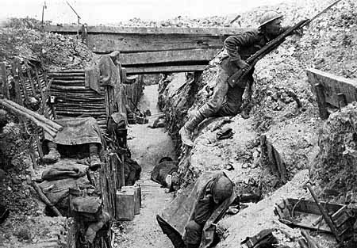
The Beginnings of WWI

Slide 2
European Empires
Otto Von Bismarck unites the German territories under the Prussian monarch Kaiser Wilhelm I (Germany)
Wilhelm II is the grandson of the Queen Victoria (England)
Wilhelm II is the cousin of Czar Nicholas II of the Russian Empire

Slide 3
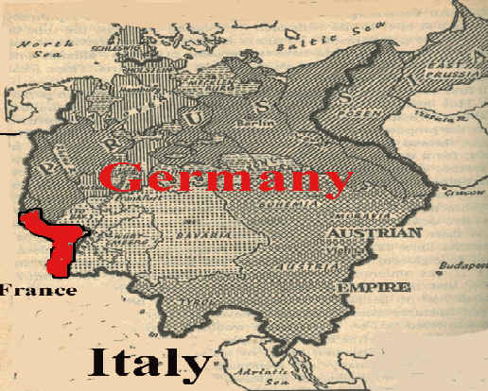
Franco-Prussian War
Germany obtains the land known as Alsace-Lorraine (Franco-Prussian War 1870)

Slide 4
1888
Kaiser Wilhelm I dies
Kaiser Wilhelm II fires Otto Von Bismarck

Slide 5
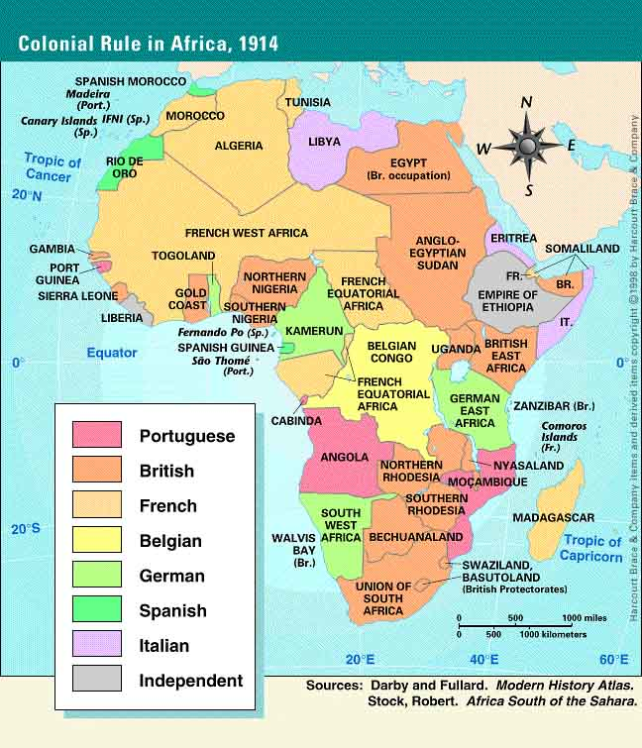
Global Interaction
Berlin Conference 1878

Slide 6
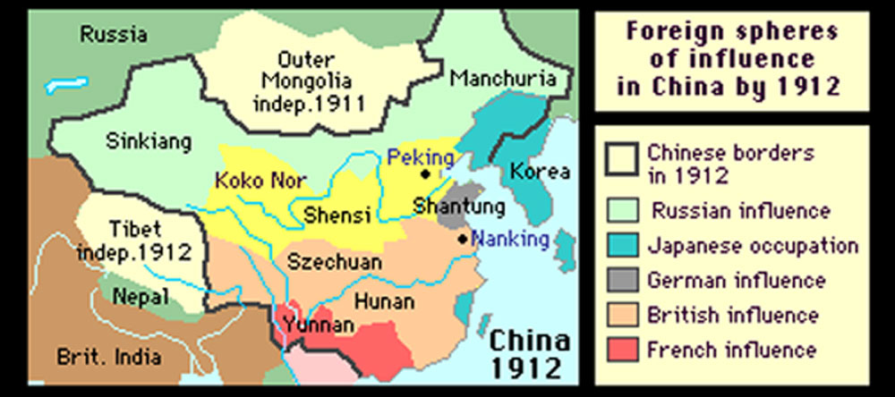
Global Interaction
Influence in China (Open Door Policy)

Slide 7
MAIN Causes
M-ilitarism
Developing a nations military.
Prior to WWI European nations developed their military capabilities in competition with other nations (Arms race)

Slide 8
MAIN Causes
M-ilitarism
Military enlistments | 1880 | 1914
Germany | 1.3 Million | 5 Million
France | 730,000 | 4 Million
Russia | 400,000 | 1.2 Million

Slide 9
MAIN Causes
A-lliances
Germany organizes the Triple Alliance with Austria-Hungary and Italy to protect itself from arch-enemy France
France organizes the Triple Entente with Russia and Great Britain

Slide 10
MAIN Causes
I-mperialism
A country can increase its power, influence, and wealth by controlling other nations, governments, or people groups.

Slide 11
MAIN Causes
N-ationalism
A strong sense of pride in a persons homeland.
Self-Determination- people who share a common identity should have their own country and government

Slide 12
Woodrow Wilson
“There’s no chance of progress and reform in an administration in which war plays a principal part” –Woodrow Wilson (campaign speech 1913)

Slide 14
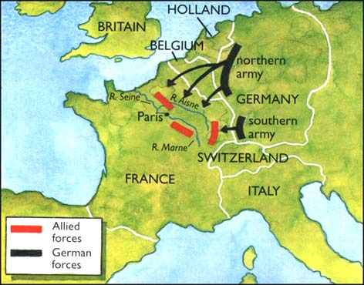
The Schlieffen Plan:
-Alfred von Schlieffen (German Army Chief of Staff)
-move 90% of troops through Belgium to take Paris, France before Russian troops can mobilize (eliminate the war on two fronts)
Allied Forces = The Triple Entente
G.B.
France
Russia
Central Powers= The Triple Alliance
German Empire
Austria-Hungarian Empire
Italy
Ottoman Empire

Slide 15
Schlieffen Plan continued….
Put into effect August 1914
Expectation The Russian troops will take 6 weeks to mobilize The Belgium forces would be unable to stop the advancement of German troops The British Troops would take weeks to mobilize Paris would fall The Great War would be ended quickly | Reality: The Russian troops mobilized quickly and advanced into East Germany The Belgium forces slowed the German advancement. The British government declared war on Germany and Great Britain quickly sent troops to aid France. Paris did not fall The German troops retreated successfully and dug trenches between the North Sea and Swiss Frontier. The War would not end quickly.

