Slide 1
1950s
Conformity, Consumerism, and Counter-Culture

Slide 2
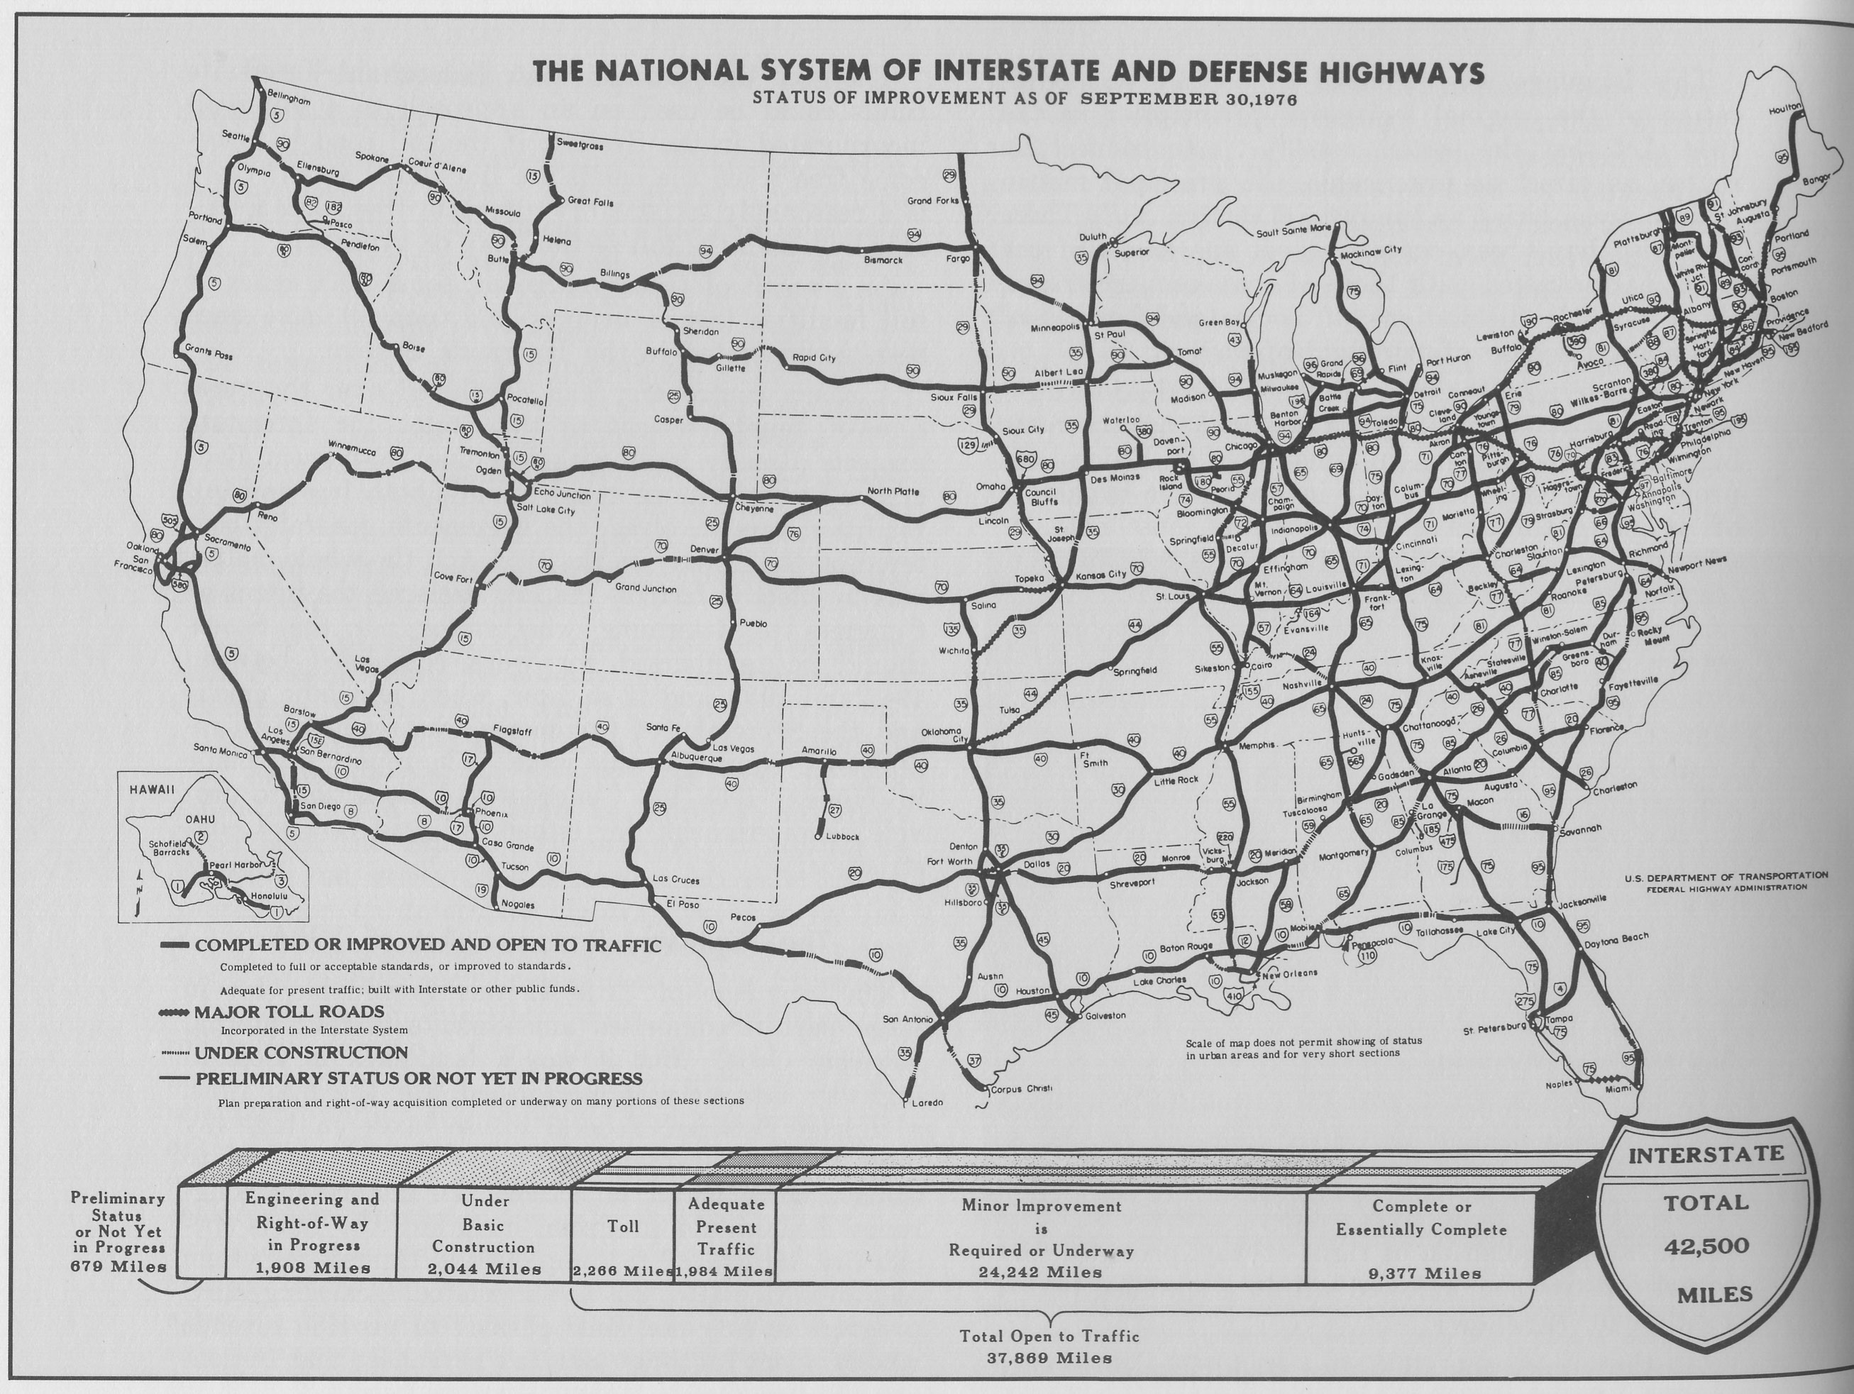
Federal Highway Act
1956 Eisenhower Administration
$25 Billion spent to build more than 41,000 miles of interstate highway
Linked the country and made national mobility much easier
Contributed to American Urbanization

Slide 3
Federal Highway Act

Slide 4
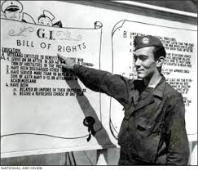
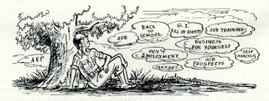
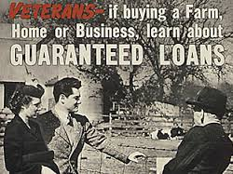
G.I. Bill
Home loans: Made homes in the suburbs more accessible
Student grants for college tuition: made college accessible for the middle class
Small business loans

Slide 5
Conformity
In Housing

Slide 6
Levittown, PA

Slide 7
Levittown, PA

Slide 8
Levittown, PA

Slide 9
Levittown, PA

Slide 10
Levittown, PA

Slide 11
Listen to the song. What is the artist’s perception of Levittowns?

Slide 12
Watch the video clip. What is the filmmakers perception of Levittowns?

Slide 13
Conformity
In the workplace

Slide 15
Consumerism

Slide 17
Television
I Love Lucy
Leave It to Beaver
Honeymooners
Father Knows Best

Slide 20
The Automobile

Slide 24
Youth Culture
Rock and Roll

Slide 25
Elvis Presley

Slide 27
Jerry Lee Lewis

Slide 28
Chuck Berry

Slide 29
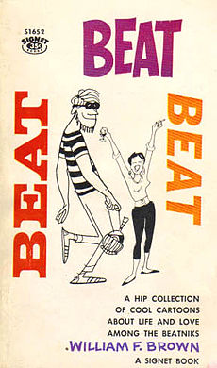
Counter Culture
Beatniks

Slide 30
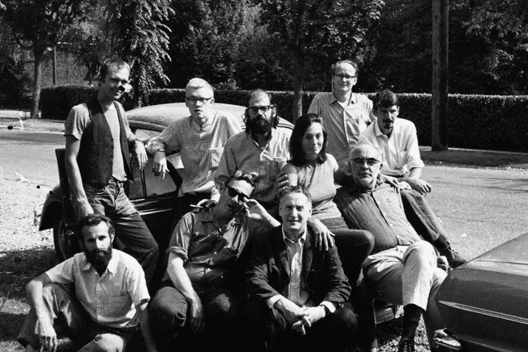
Beat Generation and Beatniks
Jack Kerouac introduced the phrase "Beat Generation" in 1948, generalizing from his social circle to characterize the underground, anti-conformist youth gathering in New York

Slide 31
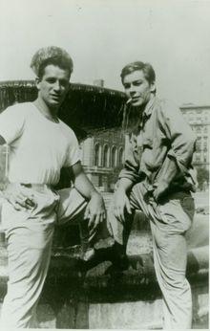
Beat Generation and Beatniks
Centralized in Greenwich Village (New York) and San Francisco, California
Jack Kerouac On the Road
Allen Ginsberg Howl
Lucien Carr Columbia University

