Slide 1
Cyber Threats

Slide 2
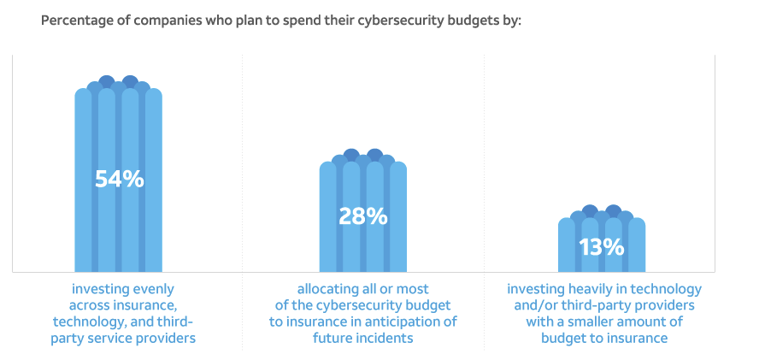
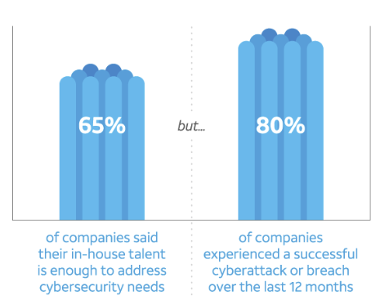
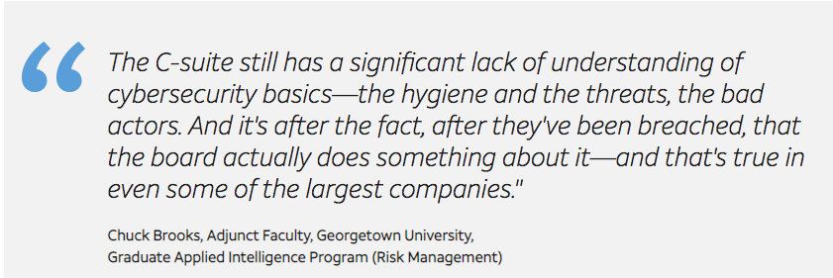
Statistics
Jr. High/High Schoolers who sleep approximately 8 hours a day usually spend roughly ½ of their time awake on the Internet
94% of teens ages 12-17 go online to do research
91% of 18-24 year-olds say they’re social networking “friends” with people they don’t know well
The Number One digital password in the U. S. is “password.”
30% of 18-24 year-olds admit that they’ve tried to guess another person’s password
Only 23% of teachers feel adequately prepared to teach kids the risks of cyberbullying
Just 24% of teachers believe they know how to teach young people how to protect their personal information online
-CyberSecurityU.org

Slide 3
Cyber Attacks
Large databases
Point of sale systems
Political systems and infrasctucture

