Slide 1
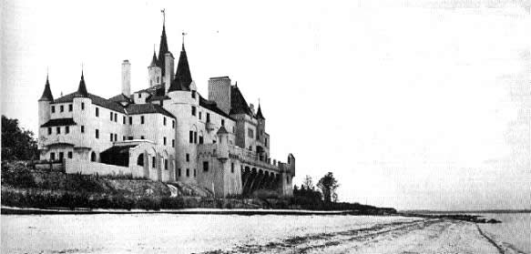
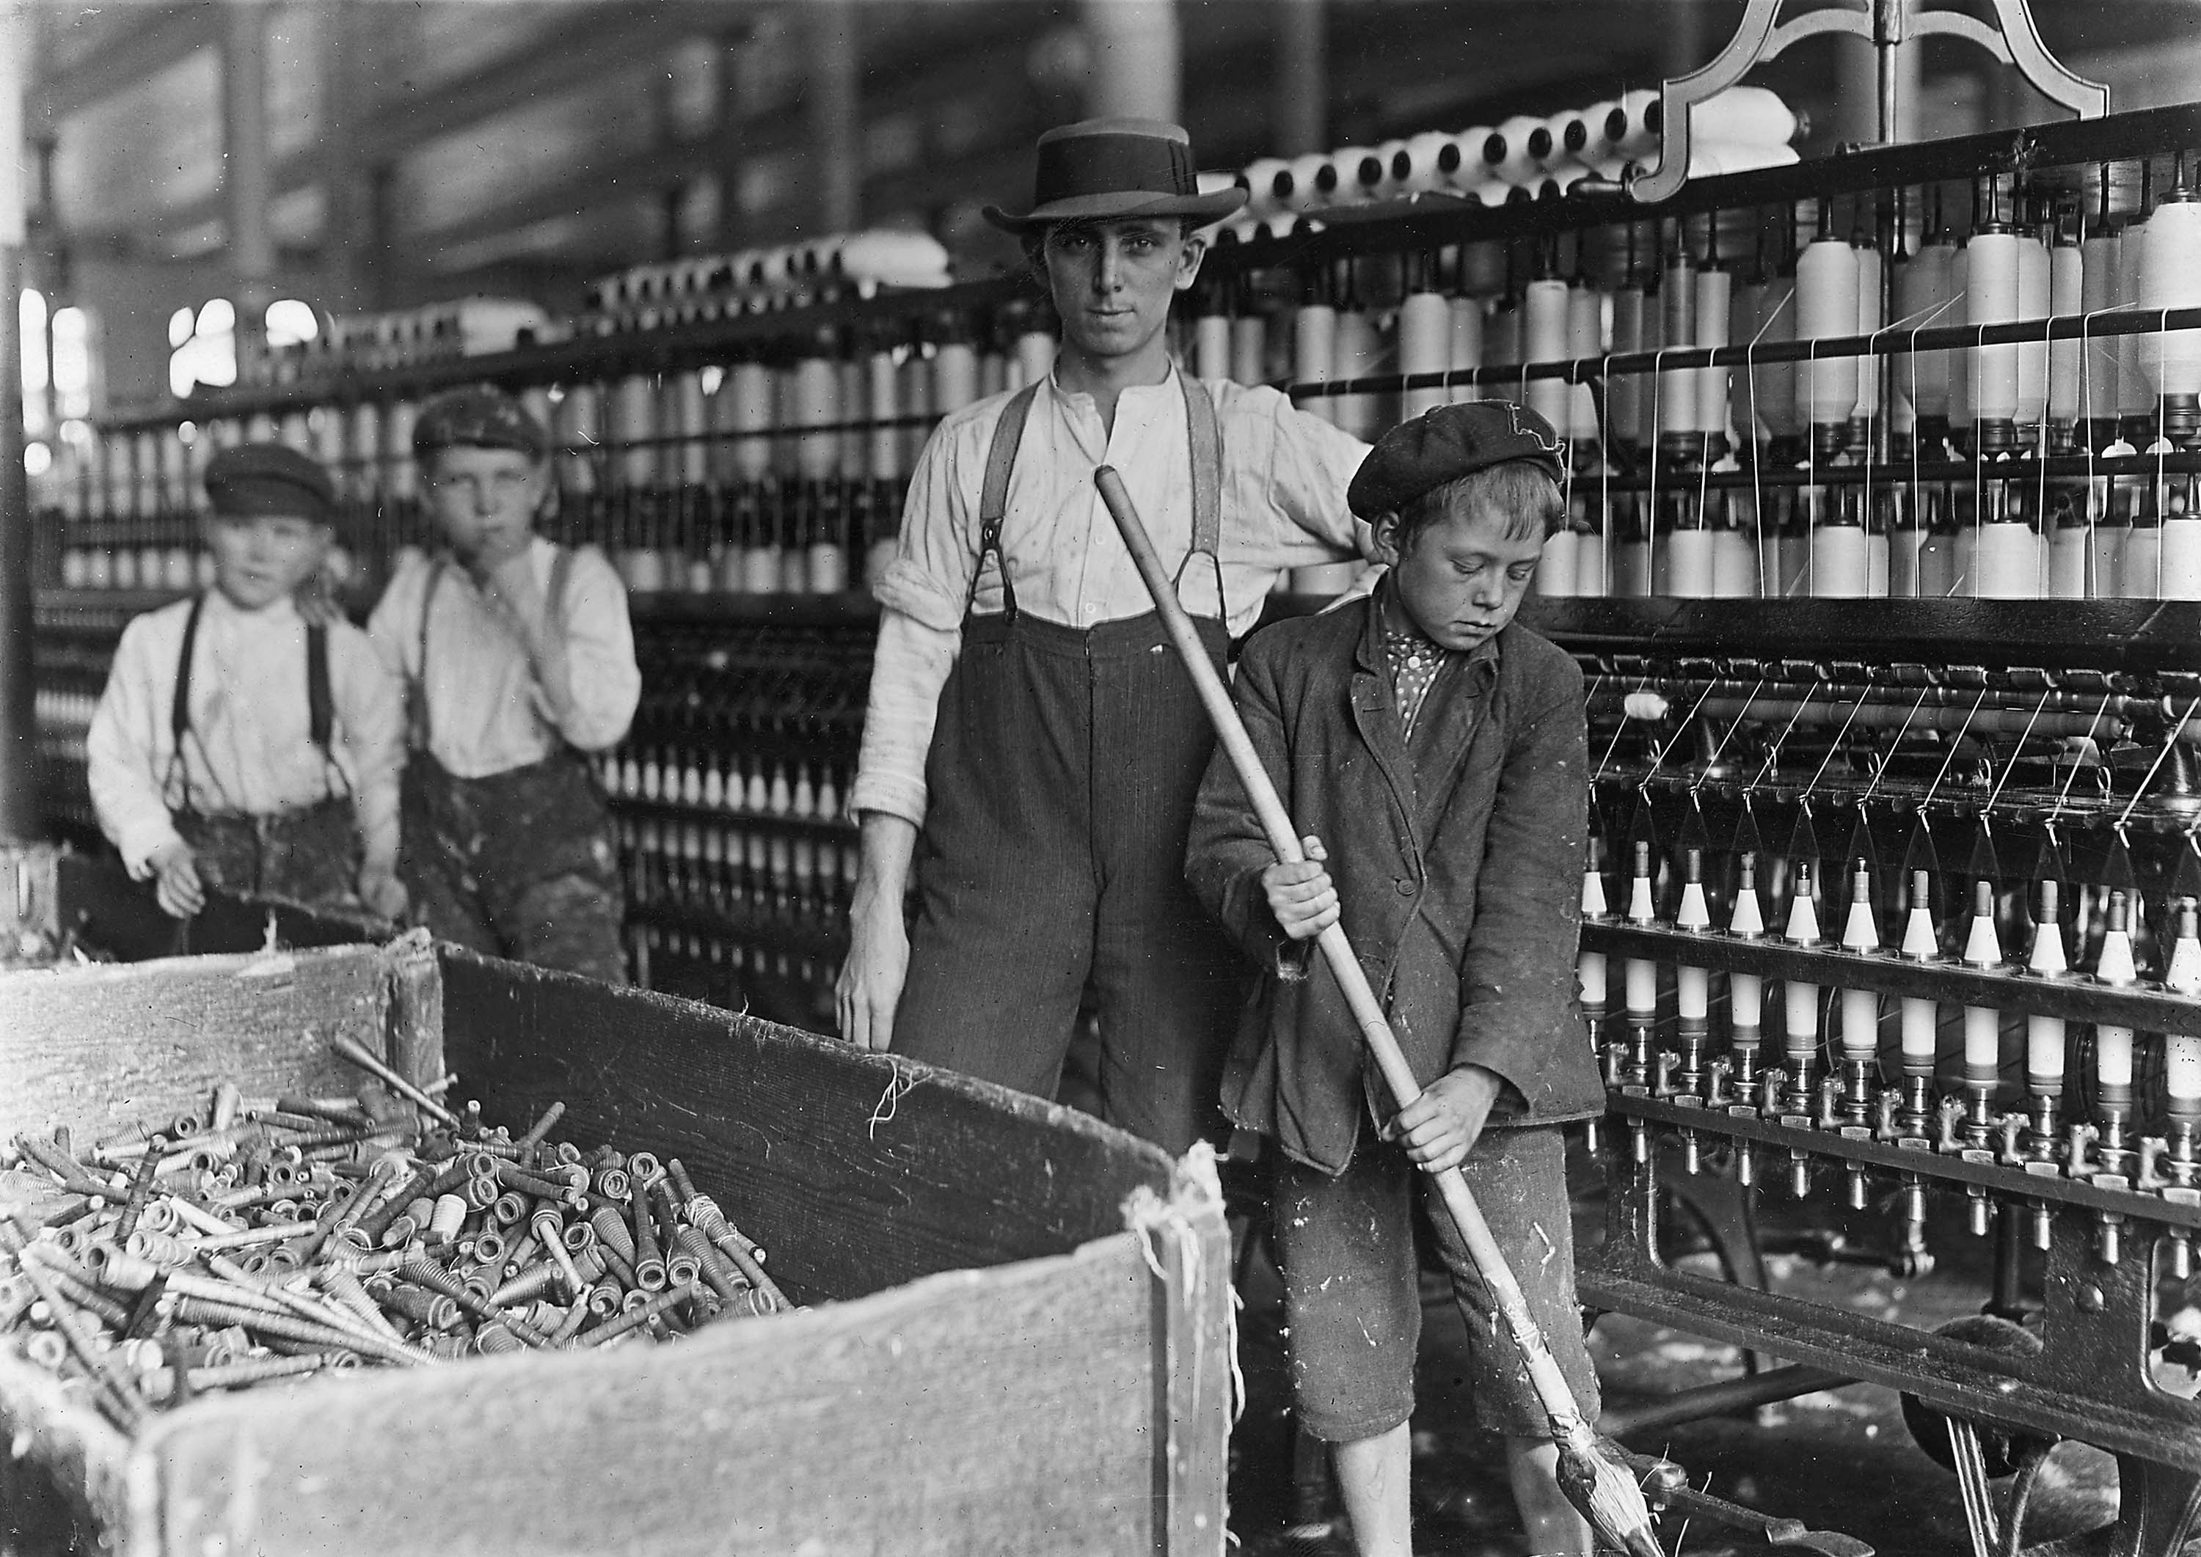
The Gilded Age
“Something covered in gold on the outside, but made of cheaper material inside”

Slide 2
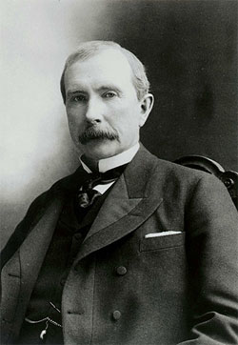
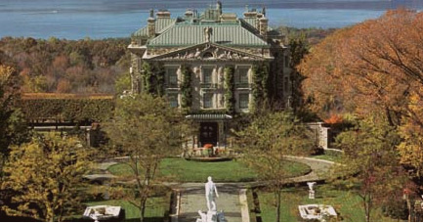
John Rockefeller
Organized Standard Oil by horizontally monopolizing the Oil refinement industry
Wealth estimated at between 50-80 billion dollars (today’s worth)
Philanthropist (Charity): Social Darwinism philosophy
Social Darwinism

Slide 3
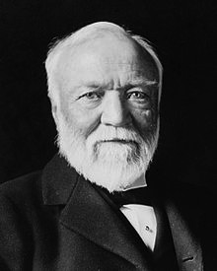
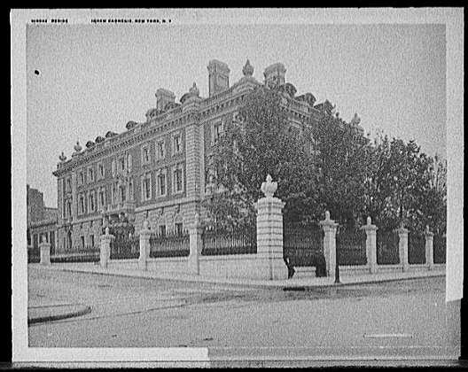
Andrew Carnegie
Organized U.S. Steel by vertically monopolizing the steel industry and production process
Philanthropist: Gospel of Wealth philosophy
Donated millions of dollars to build schools hospitals (targeted at aiding the poor)
Self-Made billionaire

Slide 4
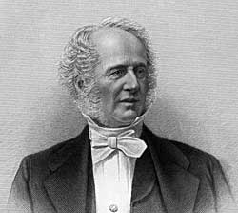
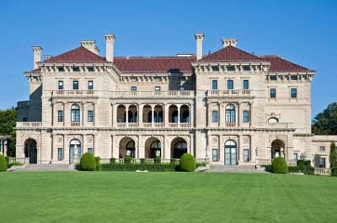
Cornelius Vanderbilt
Transportation: Became a railroad baron by buying existing railroad lines and consolidating transportation
Engaged in Philanthropy near the end of his life
Founded Vanderbilt University in Nashville Tennessee

Slide 5
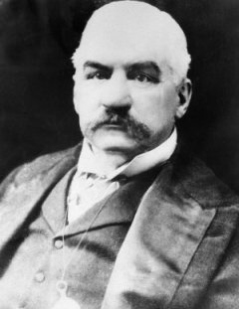
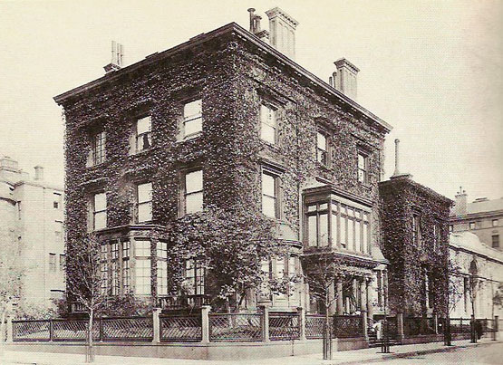
J.P. Morgan
Financier: Organized trusts to buy major companies and industries.
Examples: General Electric, and United States Steel Corporation
Trust busters targeted his organizations

Slide 6
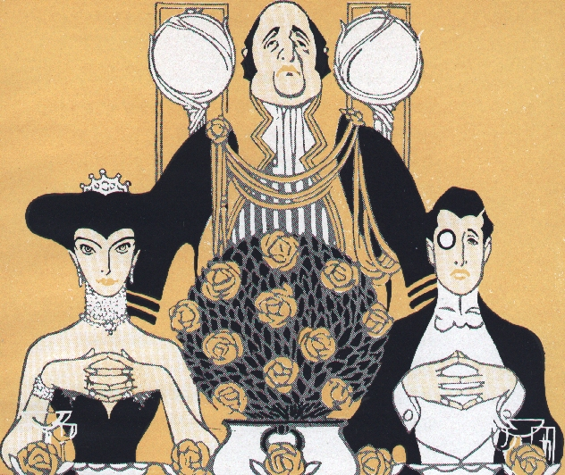
Class Division
Upper Class “High Society”
Built mansions
Hired servants and cooks
Spent lavishly on events and parties
Examples of excess

Slide 7
Class Division
Middle Class
Doctors, Lawyers, Engineers, Managers, Social Workers, Architects, and Teachers
Moved to the edge of cities to escape crime, disease, and poverty
Very small middle class

Slide 8
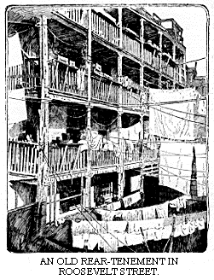
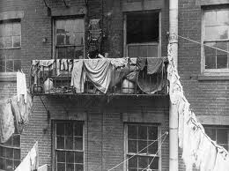
Class Division
The Working Class
Multiple families lived in tenements
Family economy survived on less than $1000 per year

Slide 9
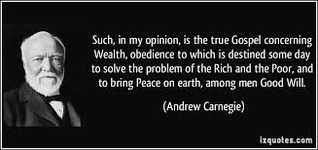
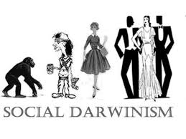
Social Theories
Gospel of Wealth
Social Darwinism

