Slide 1
Immigration

Slide 2
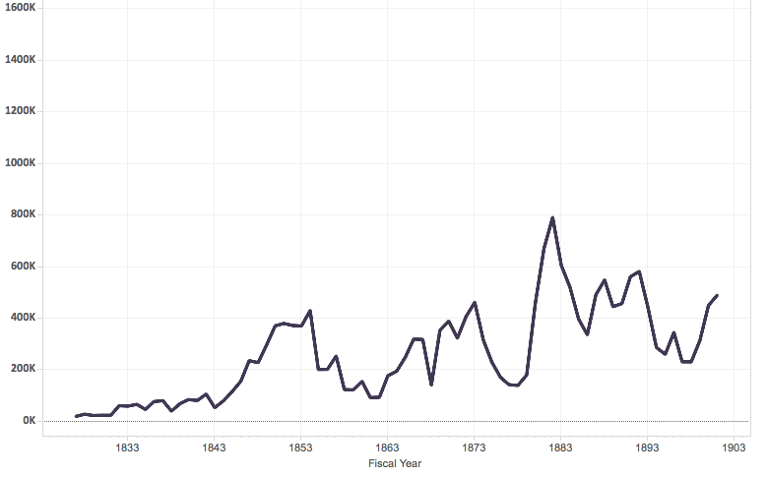
Immigration Statistics 1833 to 1903

Slide 3
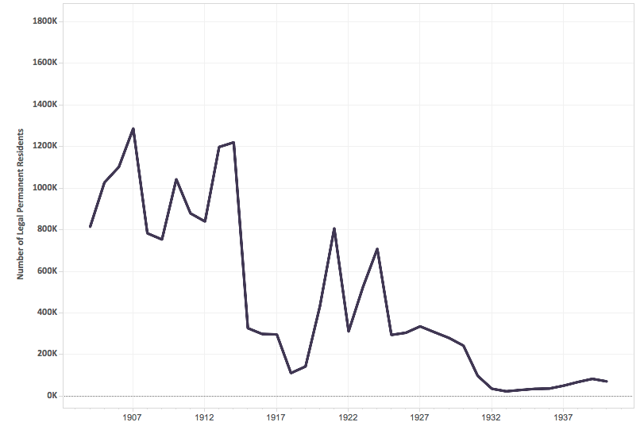
Immigration Statistics 1904 to 1940

Slide 4
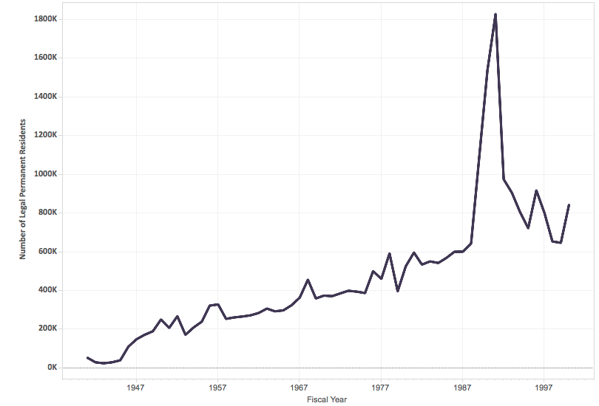
Immigration Statistics 1941 to 2000

Slide 5
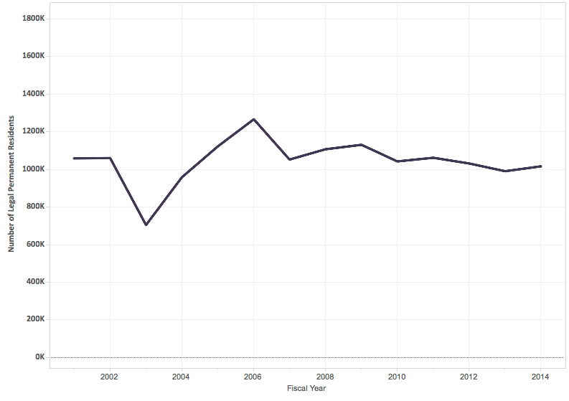
Immigration Statistics 2000 to 2014

Slide 6
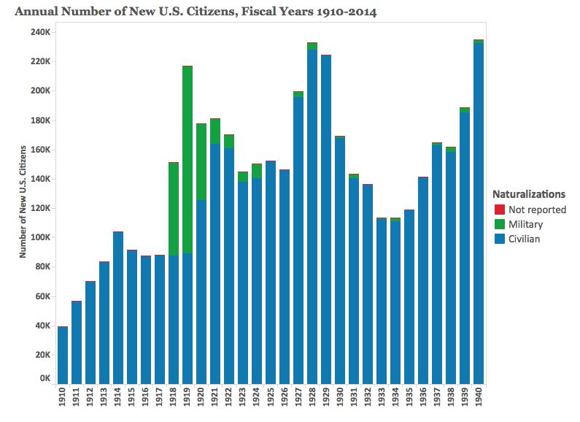
New Citizens added to the United States 1910 to 1940

Slide 7
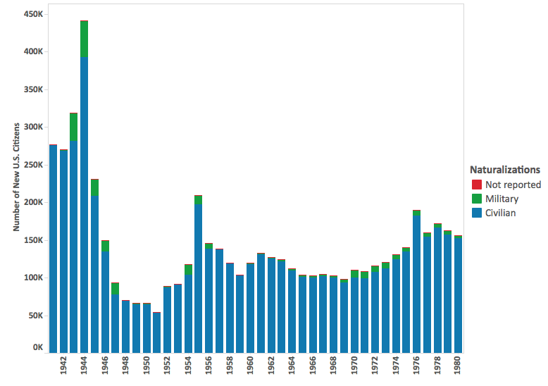
New Citizens added to the United States 1940 to 1980

Slide 8
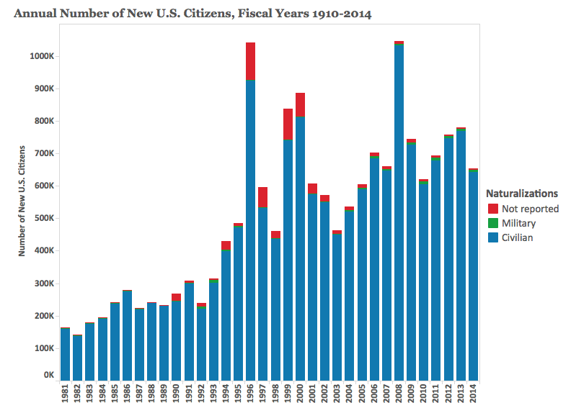
New Citizens added to the United States 1981 to 2014

Slide 9
Family-Based Immigration
Immediate relatives:
Spouses of U.S. Citizens
Unmarried minor children of U.S. citizens (under 21 years old)
Parents of U.S. Citizens (petitioner must be 21 years old)
Family Preference System
Adult children
Spouses and unmarried children

Slide 10
Employment-Based Immigration (240,000 total)
The U.S. provides various ways for immigrants with various skills to come to the United States (permanently and temporarily)
Temporary Visa:
Employers can hire and/or petition for a specific worker. Many different categories exist. A worker must leave the country when the visa expires or the worker gets fired.
Permanent Immigration:
Persons with extraordinary ability
Advanced degrees in Arts, Sciences, or Business
Skilled workers with advanced training
Special immigrants (religious affiliation, government workers, etc.)
Persons who invest 500,000 to 1,000,000 in a business that employs at least 10 employees.

Slide 11
Per-country ceilings
Currently, no group of permanent immigrants (family-based and employment-based) from a single country can exceed seven percent of the total amount of people immigrating to the United States in a single fiscal year.

Slide 12
Refugees and Asylees
Refugees are admitted to the United States based upon an inability to return to their home countries because of a “well-founded fear of persecution” due to their race, membership in a particular social group, political opinion, religion, or national origin.
The admission of refugees turns on numerous factors, such as the degree of risk they face, membership in a group that is of special concern to the United States (designated yearly by the President of the United States and Congress), and whether or not they have family members in the United States.
Each year the President, in consultation with Congress, determines the numerical ceiling for refugee admissions.

Slide 13
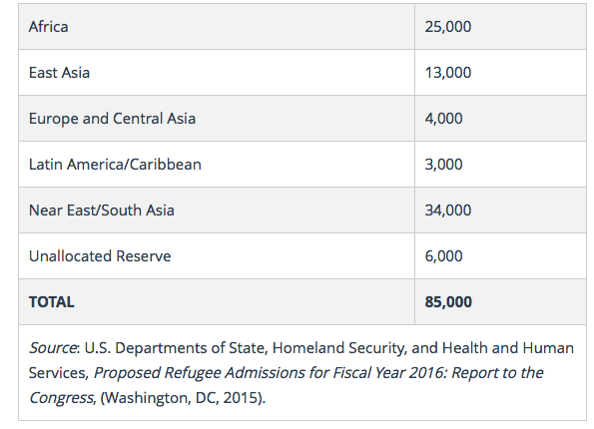
Refugees by region (2016)

Slide 14
Diversity Visa Program
Each year 55,000 visas are allocated randomly to nationals from countries that have sent less than 50,000 immigrants to the United States in the previous 5 years.
To be eligible for a diversity visa, an immigrant must have a high-school education (or its equivalent) or have, within the past five years, a minimum of two years working in a profession requiring at least two years of training or experience.

Slide 15
Citizenship
In order to qualify for U.S. citizenship through naturalization, an individual must have had LPR status (a green card) for at least five years (or three years if he or she obtained the green card through a U.S.-citizen spouse or through the Violence Against Women Act, VAWA).
Applicants for U.S. citizenship must be at least 18-years-old, demonstrate continuous residency, demonstrate “good moral character,” pass English and U.S. history and civics exams (with certain exceptions), and pay an application fee, among other requirements.

Slide 16
Illegal Immigration
The United States Department of Homeland Security (DHS) has estimated that 11.4 million unauthorized immigrants lived in the United States in January 2012. According to DHS estimates, "the number of illegal immigrants peaked around 12 million in 2007 and has gradually declined to closer to 11 million.”
The U.S. civilian workforce included 8 million unauthorized immigrants in 2014, accounting for 5% of those who were working or were unemployed and looking for work.
Mexicans made up 52% of all unauthorized immigrants in 2014, though their numbers had declining in recent years.
Six states accounted for 59% of unauthorized immigrants on 2014: California, Texas, Florida, New York, New Jersey, and Illinois.
A rising share of unauthorized immigrants have lived in the U.S. for at least a decade.

