Slide 1
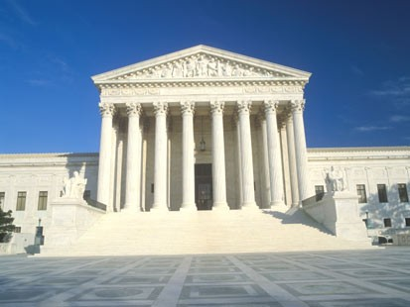
The Judicial Branch

Slide 2
Jurisdiction
The authority to hear certain court cases
State courts have jurisdiction over state laws
Federal courts have jurisdiction over
U.S. laws
Treaties with foreign nations
Interpretations of the Constitution
Etc.:
Representatives of foreign governments (ambassadors)
Conflicts between States
Federal Gov./ Agencies
Conflict between citizens from different States

Slide 3
United States Supreme Court
Congress establishes the number of justices
Both original and appellate jurisdiction
Nominated by the President, and confirmed by the Senate

Slide 4
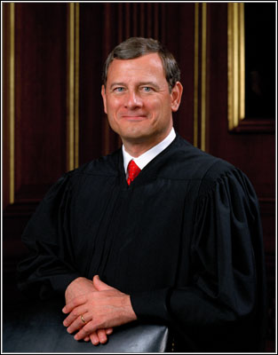
The United States Supreme Court
Chief Justice
John Roberts (2005-present) Nominated by George W. Bush
Education: John Roberts attended Harvard College and earned a degree in 1976. Roberts graduated from Harvard Law School in 1979.
Judicial Offices: John Roberts was appointed to the United States Court of Appeals for the District of Columbia Circuit in 2003. President George W. Bush nominated him as Chief Justice of the United States, and he took his seat on September 29, 2005

Slide 5
1. The Chief Justice enters the courtroom first and casts the first vote when the justices deliberate. The Chief Justice's vote carries has no more influence than the votes of the Associate Justices.
2. If the Chief Justice votes with the majority in a case decided by the Supreme Court, he or she may choose to write the Court's opinion, or to assign the task to one of the Associate Justices.
3. The Chief Justice sits as the judge in impeachments of the President of the United States. Only two Chief Justices have ever served this roll: Chief Justices, Salmon P. Chase presided over the Senate trial of President Andrew Johnson in 1868, and the late William H. Rehnquist presided over the trial of President William Clinton in 1999.
4. The Chief Justice swears in the President of the United States at inaugurations. This is a purely traditional role. According to law, any federal or state judge, even a notary-public, is empowered to administer oaths of office.

Slide 6
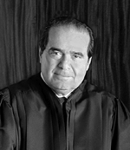
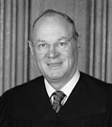
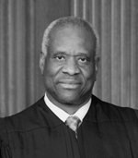
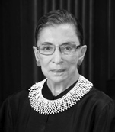
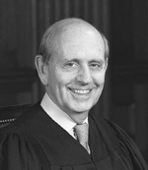
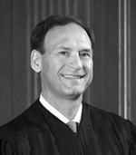
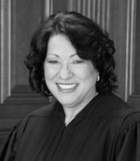
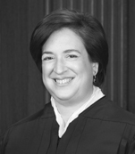
Associate Justices:
Antonin Scalia: (1986- Present) Harvard Law, Nominated by Ronald Reagan
Anthony M. Kennedy: (1988- Present) Harvard Law, Nominated by Ronald Reagan
Clarence Thomas: (1991- Present) Yale Law, Nominated by George Bush
Ruth Bader Ginsburg: (1993- Present) Columbia Law, Nominated by Bill Clinton
Stephen Breyer: (1994-present) Harvard Law, Nominated by Bill Clinton
Samuel Alito: (2006-present) Nominated by George W. Bush
Sonia Sotomayor: (2009-Present) Yale Law, Nominated by Barack Obama
Elena Kagan: (2010- Present) Harvard Law, Nominated by Barack Obama

Slide 7
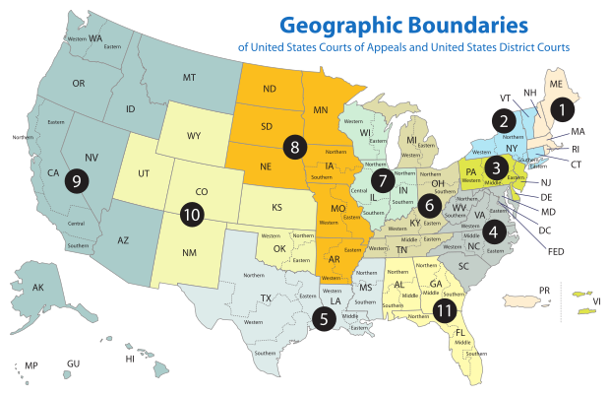
United States Court of Appeals

Slide 8
Federal District Courts
94 total districts nationwide
At least 1 per State
As many as 4 total
Grand Jury (16-23 members)
Issue indictments
Drop charges
Trial Jury (6-12 members)
Criminal or civil case
Issue guilty or not guilty verdict

Slide 9
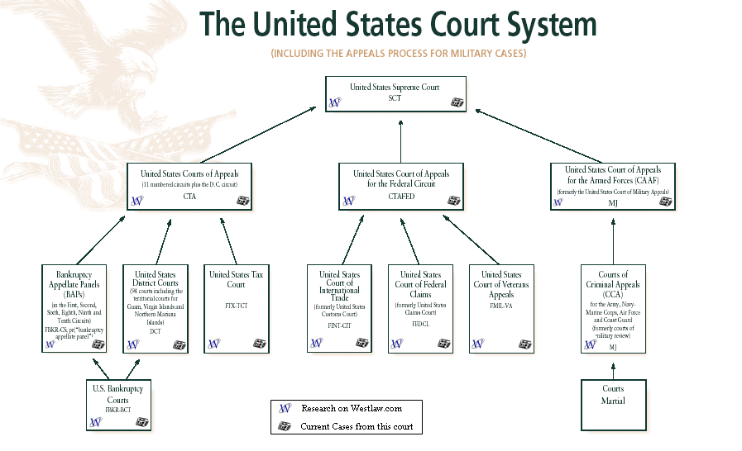
Consult the chart on page 306

Slide 10
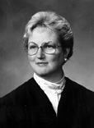
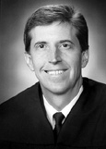
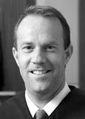
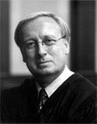
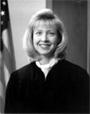
Utah State Supreme Court
CHIEF JUSTICE CHRISTINE M. DURHAM
Associate Chief Justice Matthew B. Durrant
Associate Justice Thomas R. Lee
Associate Justice Ronald Nehring
Associate Justice Jill Parrish

Slide 11
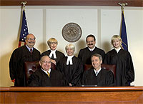
Utah Court of Appeals
Consists of seven judges who serve six-year renewable terms. A presiding judge is elected by majority vote to serve for two years.

Slide 12
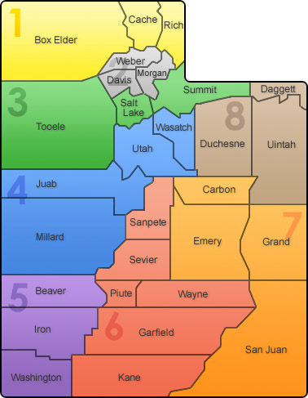
Utah district court

Slide 13
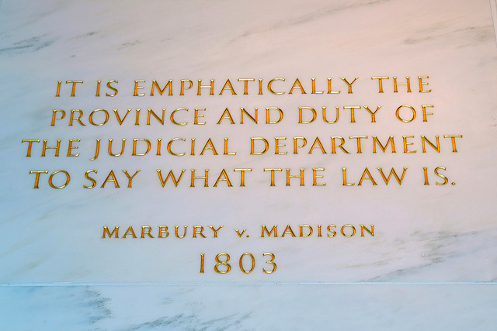
Judicial Review
Power of the Judicial Branch to determine the constitutionality of laws, executive orders, and/or prior judicial rulings
Established by John Marshall in Marbury V. Madison

Slide 14
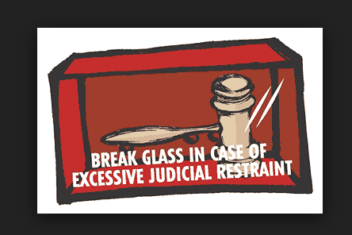
Judicial Restraint
Theory of judicial interpretation that explains that Justices should only determine a law unconstitutional if it is clearly unconstitutional.
Also, Justices that practice judicial restraint typically follow past precedents established by past judges

Slide 15
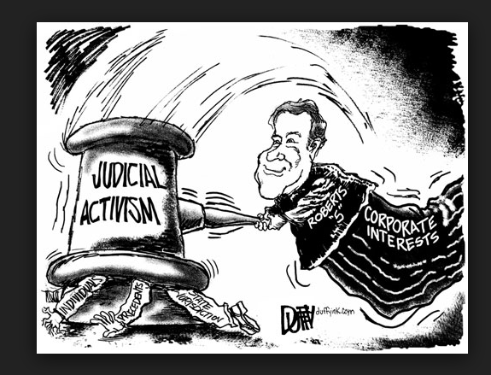
Judicial Activism
Judicial rulings based on a judges political opinions rather than past court cases or legal precedent.
Judicial Activism is thought to be the opposite of Judicial Restraint

Slide 16
Judicial Legislation
Laws held to be created by the decisions made by a judge that departs from a strict interpretation of the law.

Slide 17
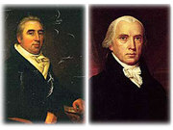
Marbury v. Madison

Slide 18
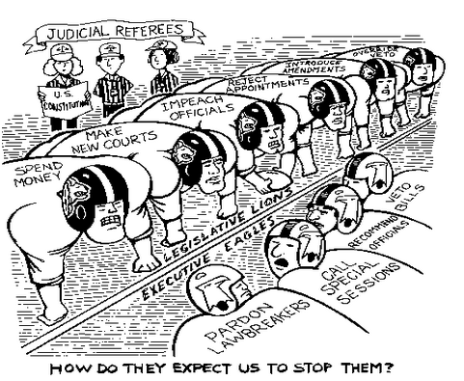
Background and Events
John Adams issues midnight appointments, but the appointment of William Marbury as the District of Columbia justice of the peace was not carried out (among other appointments)
Thomas Jefferson tells his Secretary of State James Madison not to carry out the appointment(s).
Marbury sues to have the appointment delivered.

Slide 19
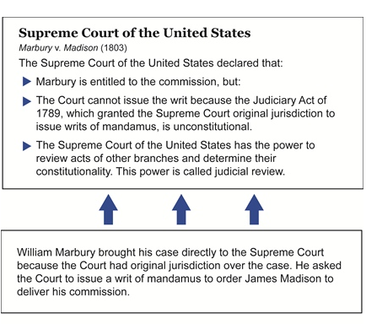
Decision

