Slide 1
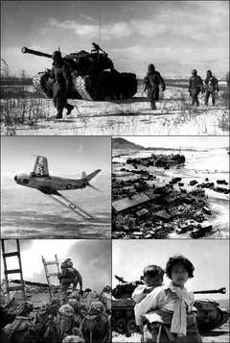
The Korean War
1950-1953

Slide 2
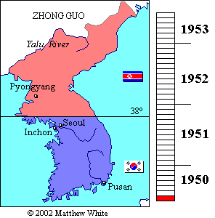
Causes
The United States and the Soviet Union divide Korean along the 38th parallel
A. Soviets support the North
B. Americans support the South
C. North Korea invades South Korea

Slide 3
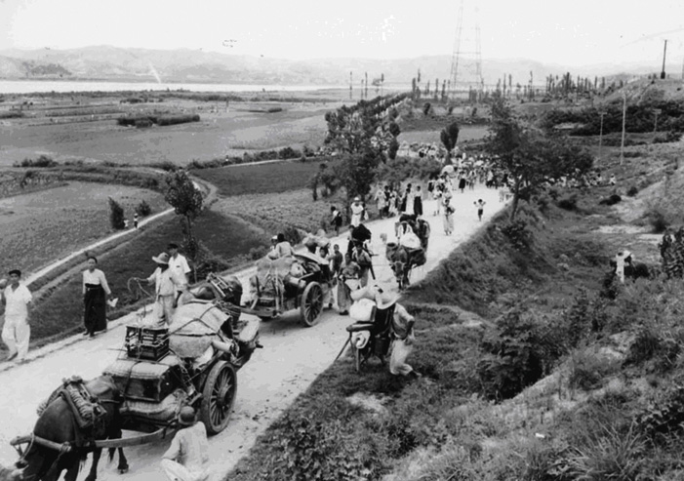
Causes
2. The Truman Doctrine argues for containment. Truman authorizes MacArthur to invade Korea

Slide 4
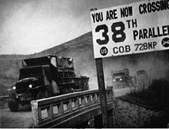
38th Parallel
Division between North and South Korea. Along the Latitudinal line 38 degrees.

Slide 5
MacArthur vs. Truman
China enters the war and pushes South Korean/ American troops south
Truman: Limited war. No atomic weapons. Do not invade China.
MacArthur: There is no substitute for victory. Use atomic weapons on China. Block Chinese ports using Chinese nationalist forces.
Truman fires MacArthur in 1951

Slide 6
Results
33,500 + American Soldiers dead
America begins arms build up
America becomes militarily involved in Asia (Cold War)
Sign defense agreements with Japan, South Korea, the Philippines, and Australia

