Slide 1
The Economic Causes of
World War II

Slide 2
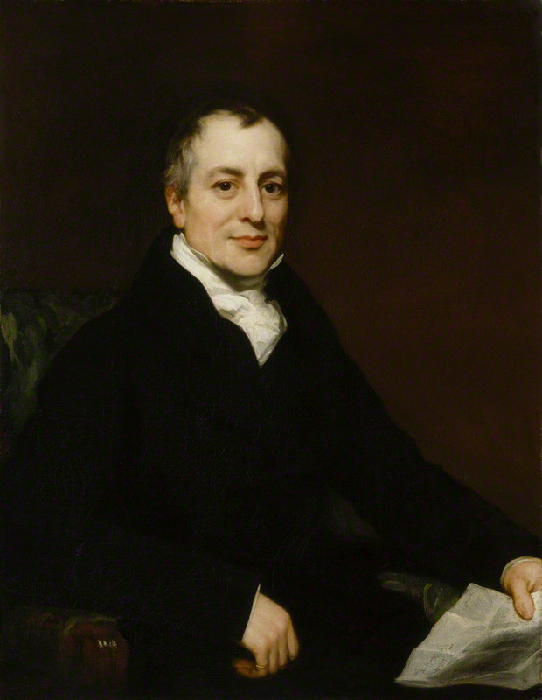
Economics and World War II
Even if one country is more efficient in the production of all goods than another, both countries will still gain by trading with each other, as long as they have different relative efficiencies.

Slide 3
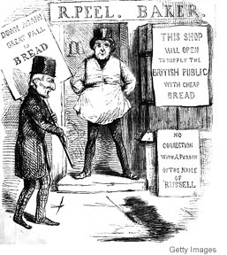
Economics and World War II
On 27 January 1846, Peel gave a three-hour speech saying that the Corn Laws would be abolished on 1 February 1849 after three years of gradual reductions of the tariff, leaving only a 1 shilling duty per quarter. Benjamin Disraeli and Lord George Bentinck emerged as the most forceful opponents of repeal in Parliamentary debates, arguing that repeal would weaken landowners socially and politically and therefore destroy the "territorial constitution" of Britain by empowering commercial interests.
Notes:
On 27 January 1846, Peel gave a three-hour speech saying that the Corn Laws would be abolished on 1 February 1849 after three years of gradual reductions of the tariff, leaving only a 1 shilling duty per quarter.[15] Benjamin Disraeli and Lord George Bentinck emerged as the most forceful opponents of repeal in Parliamentary debates, arguing that repeal would weaken landowners socially and politically and therefore destroy the "territorial constitution" of Britain by empowering commercial interests.[16]
On the third reading of Peel's Bill of Repeal (Importation Act 1846) on 15 May, MPs voted 327 votes to 229 (a majority of 98) to repeal the Corn Laws. On 25 June the Duke of Wellington persuaded the House of Lords to pass it. On that same night Peel's Irish Coercion Bill was defeated in the Commons by 292 to 219 by "a combination of Whigs, Radicals, and Tory protectionists".[17] On 29 June Peel resigned as Prime Minister and in his resignation speech he attributed the success of repeal to Cobden:

Slide 4
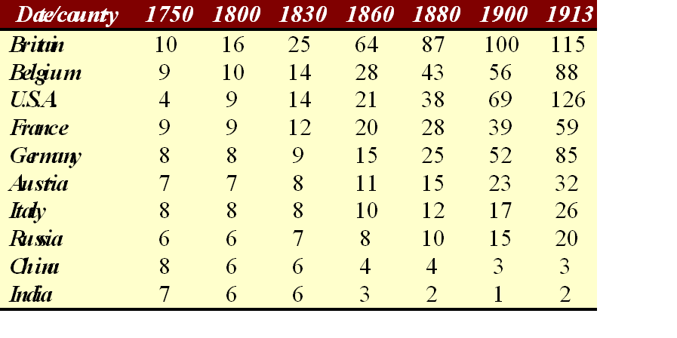
Industrialization
N.B. All entries are based on an index of 100, equal to the per capita level of industrialization in Great Britain in 1900.
Adapted from P. Bairoch, “International Industrialization Levels from 1750-1890,” Journal of European Economic History 11 (Fall 1982), p. 294. Data for Britain is actually for the United Kingdom, including Ireland with England, Wales and Scotland.
Notes:
Adam Smith and David Ricardo’s observations led to an explosion in industrialization.
This is per capita industrialization. That is, it measures the level of factories and equipment per person, with Britain in 1900 representing 100 and everyone else relative to Britain.

Slide 5
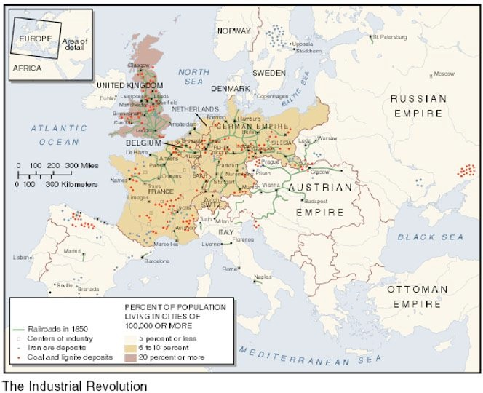
Urbanization in Europe in the Late 1800s
Notes:
With industrialization came urbanization. Two causes:
Improved agriculture and trade allowed rural population to move to urban centers
Demand for labor in factories provided incentive for population to move to urban centers

Slide 6
Problem: In a world of increasing specialization, how can you guarantee that you will continue to have access to the raw materials necessary for national survival?
Notes:
In a world of increasingly specialization, how can you guarantee that you will continue to have access to the raw materials necessary for national survival?

Slide 7
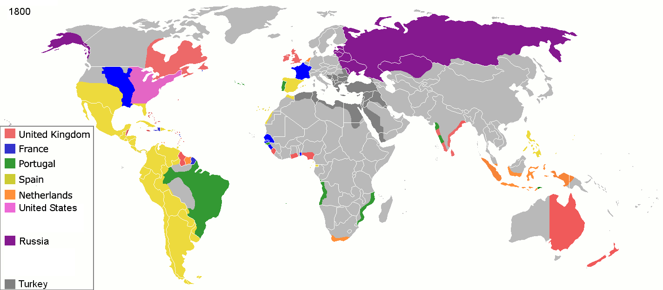
Colonialization in 1800

Slide 8
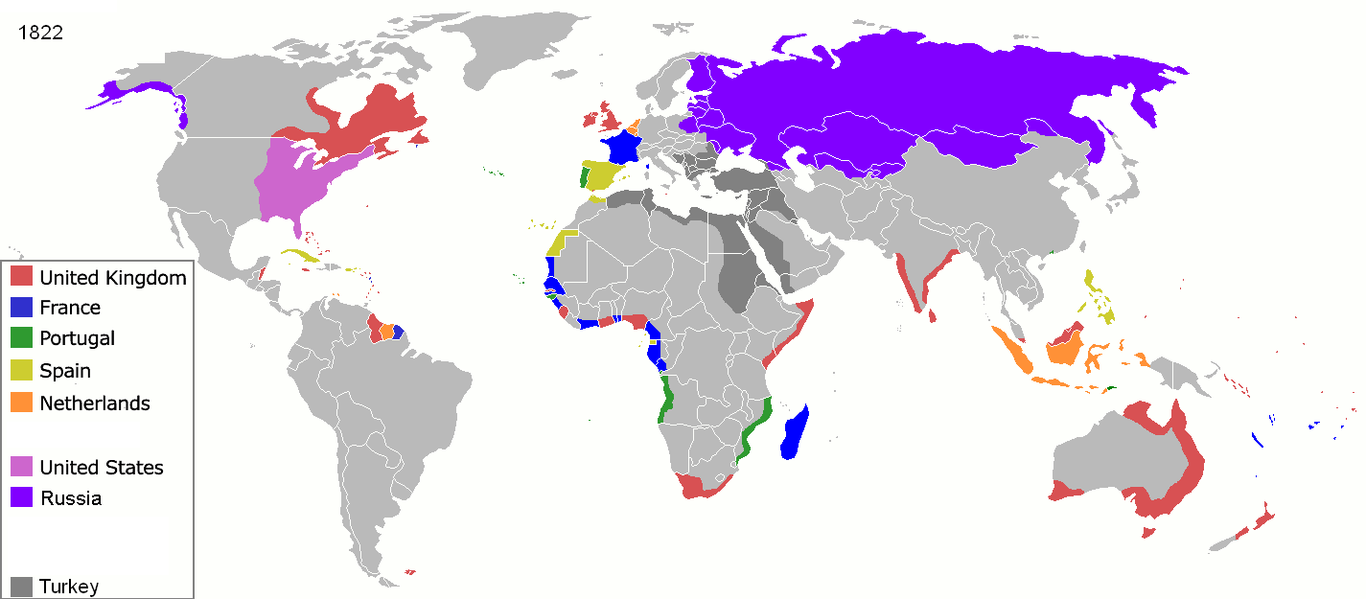
Colonialization in 1822
Notes:
Very complicated.
I will oversimplify.

Slide 9
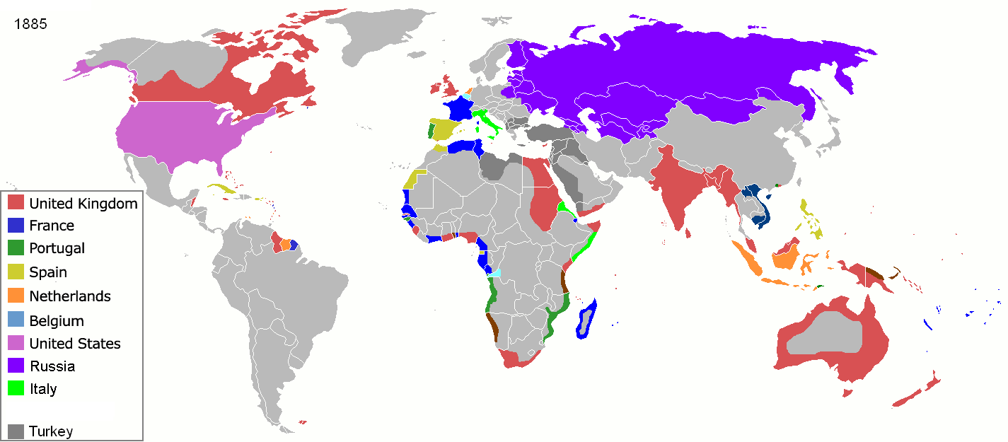
Colonialization in 1885

Slide 10
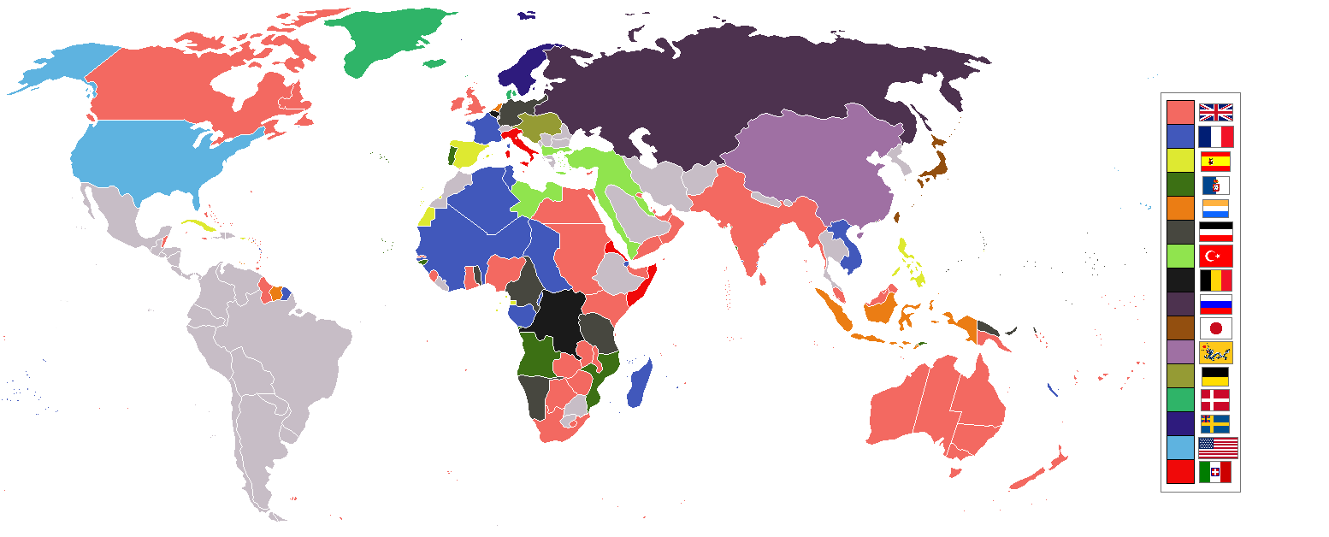
Colonialization in the 1890s
Notes:
Very complicated.
I will oversimplify.

Slide 11
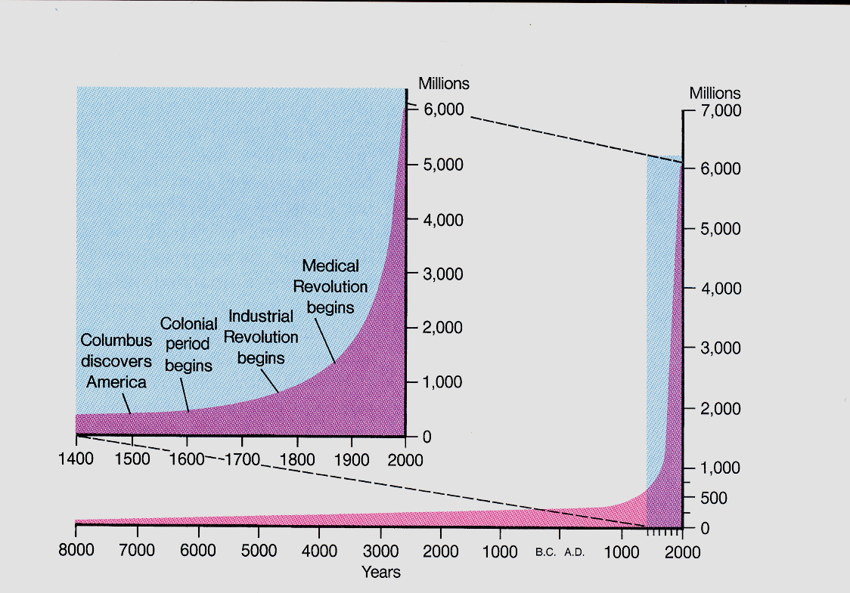
World Population Growth

Slide 12
Economics and World War
Free Trade
The Fourteen Points:
There should be no secret alliances between countries
Freedom of the seas in peace and war
The reduction of trade barriers among nations
The general reduction of armaments
The adjustment of colonial claims in the interest of the inhabitants as well as of the colonial powers
The evacuation of Russian territory and a welcome for its government to the society of nations
The restoration of Belgian territories in Germany
The evacuation of all French territory, including Alsace-Lorraine
The readjustment of Italian boundaries along clearly recognizable lines of nationality
Independence for various national groups in Austria-Hungary
The restoration of the Balkan nations and free access to the sea for Serbia
Protection for minorities in Turkey and the free passage of the ships of all nations through the Dardanelles
Independence for Poland, including access to the sea
A league of nations to protect "mutual guarantees of political independence and territorial integrity to great and small nations alike."

Slide 13
Economics and World War
The Fourteen Points:
There should be no secret alliances between countries
Freedom of the seas in peace and war
The reduction of trade barriers among nations
The general reduction of armaments
The adjustment of colonial claims in the interest of the inhabitants as well as of the colonial powers
The evacuation of Russian territory and a welcome for its government to the society of nations
The restoration of Belgian territories in Germany
The evacuation of all French territory, including Alsace-Lorraine
The readjustment of Italian boundaries along clearly recognizable lines of nationality
Independence for various national groups in Austria-Hungary
The restoration of the Balkan nations and free access to the sea for Serbia
Protection for minorities in Turkey and the free passage of the ships of all nations through the Dardanelles
Independence for Poland, including access to the sea
A league of nations to protect "mutual guarantees of political independence and territorial integrity to great and small nations alike."
Self-Determination

Slide 14
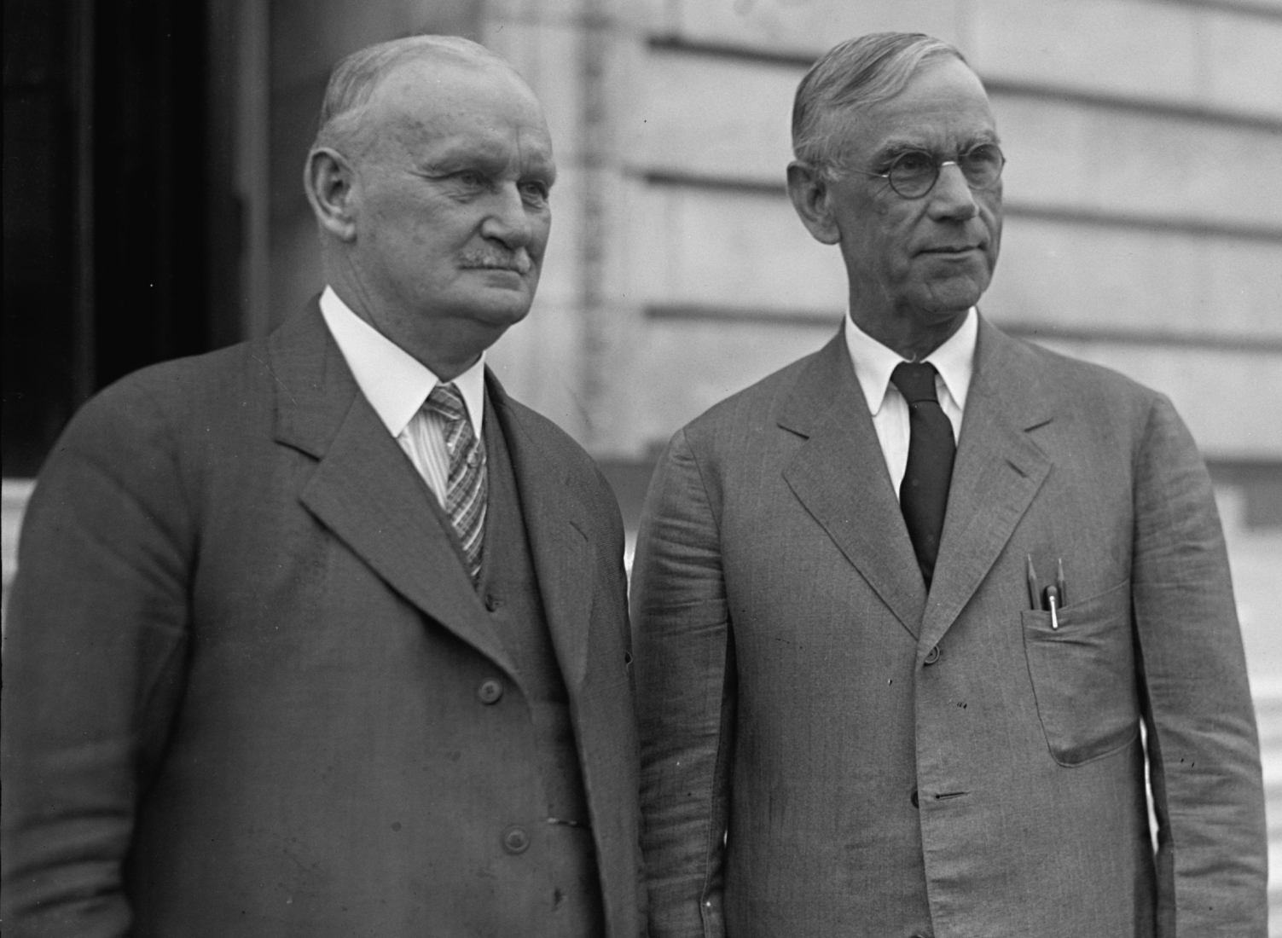
Smoot-Hawley Tariffs
Reed Smoot
Willis Hawley
Notes:
The House passed a version of the act in May 1929, increasing tariffs on agricultural and industrial goods alike. The House bill passed on a vote of 264 to 147, with 244 Republicans and 20 Democrats voting in favor of the bill.[6] The Senate debated its bill until March 1930, with many Senators trading votes based on their states' industries. The Senate bill passed on a vote of 44 to 42, with 39 Republicans and 5 Democrats voting in favor of the bill.[6] The conference committee then aligned the two versions, largely by moving to the greater House tariffs.[7] The House passed the conference bill on a vote of 222 to 153, with the support of 208 Republicans and 14 Democrats.

Slide 15
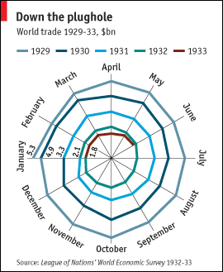
International Trade
Notes:
Threats of retaliation began long before the bill was enacted into law in June 1930. As it passed the House of Representatives in May 1929, boycotts broke out and foreign governments moved to increase rates against American products, even though rates could be increased or decreased by the Senate or by the conference committee. By September 1929, Hoover's administration had received protest notes from 23 trading partners, but threats of retaliatory actions were ignored.[7]
In May 1930, the greatest trading partner, Canada, retaliated by imposing new tariffs on 16 products that accounted altogether for around 30% of U.S. exports to Canada.[13] Canada later also forged closer economic links with the British Empire via the British Empire Economic Conference of 1932. France and Britain protested and developed new trade partners. Germany developed a system of autarky.

Slide 16
World War I Reparations
The Logic of Reparations…
Germans Pay French, British and Italians |  | French, British and Italian pay US |  | U.S. gets all the Gold

Slide 17
Economics and World War

Slide 18
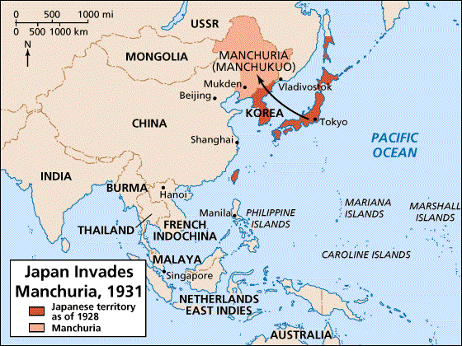
Japanese Economy
Living Space
Raw materials:
Iron ore
Coal
Notes:
For Japan, the division of the world into trading blocs proved devastating.
Political elites grew increasingly concerned that Japan would not have access to the raw materials necessary to sustain an industrialized economy.
Foremost among these were coal and iron ore. Japan’s military elite in particular began to see Manchuria as a logical area to expand Japan’s empire.

Slide 19
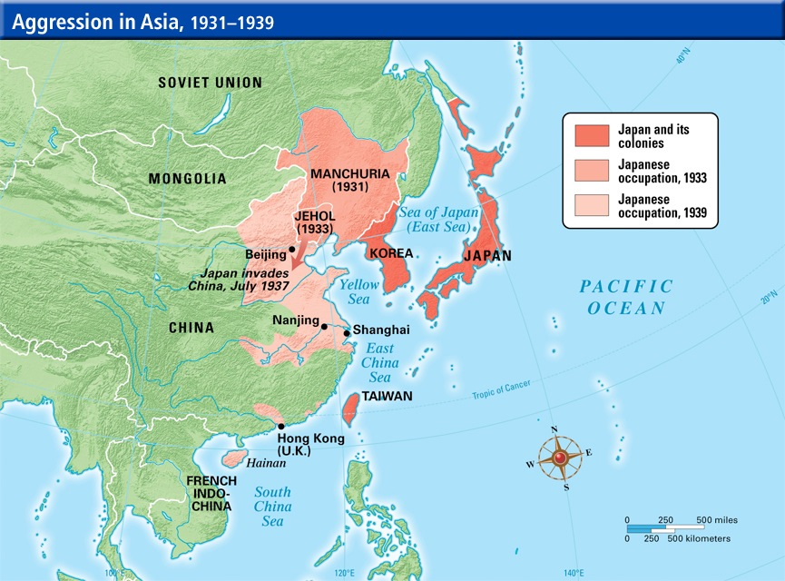
Japanese Economy
Notes:
In 1937, Japan swept down the coast of China in part to respond to growing Chinese unrest at having the Japanese army on its borders.

Slide 20
Japanese Problems with Resources
French Indochina
Raw materials:
Rice
Dutch East Indies
Raw materials:
Oil
Rubber
Notes:
Irony is that China became for Japan a war that

Slide 21
Population of Germany

Slide 22
German Pop. Density

Slide 23
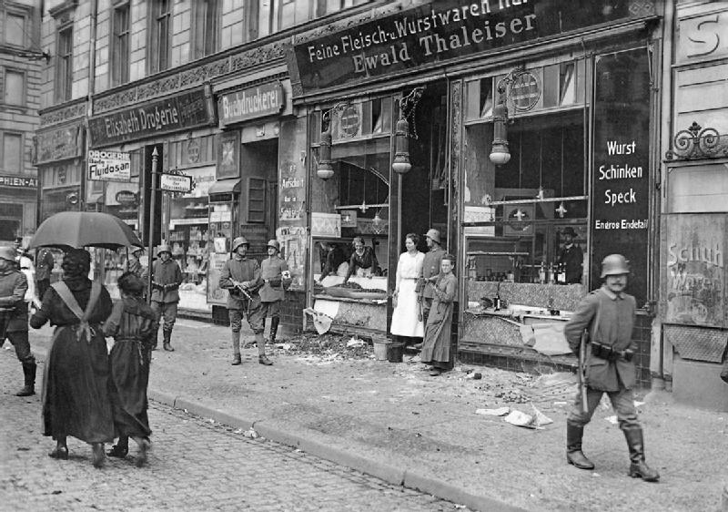
German Food Riots
Notes:
Food riots began erupting in 1917.

Slide 24
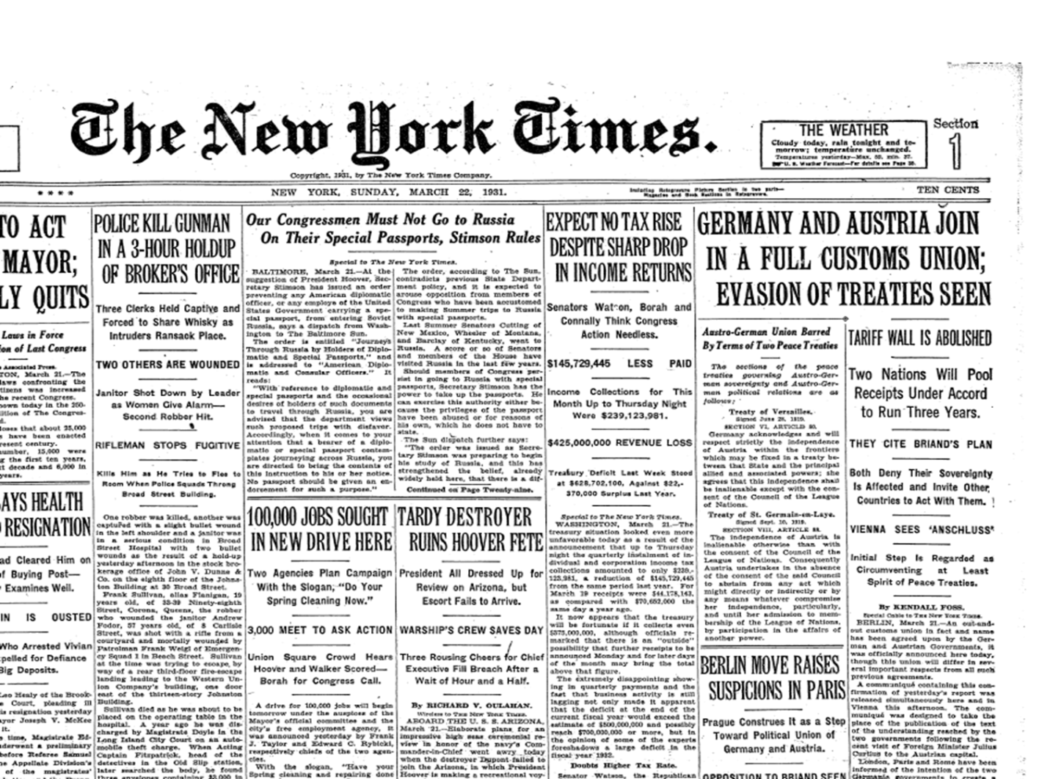
Notes:
March 1931

Slide 25
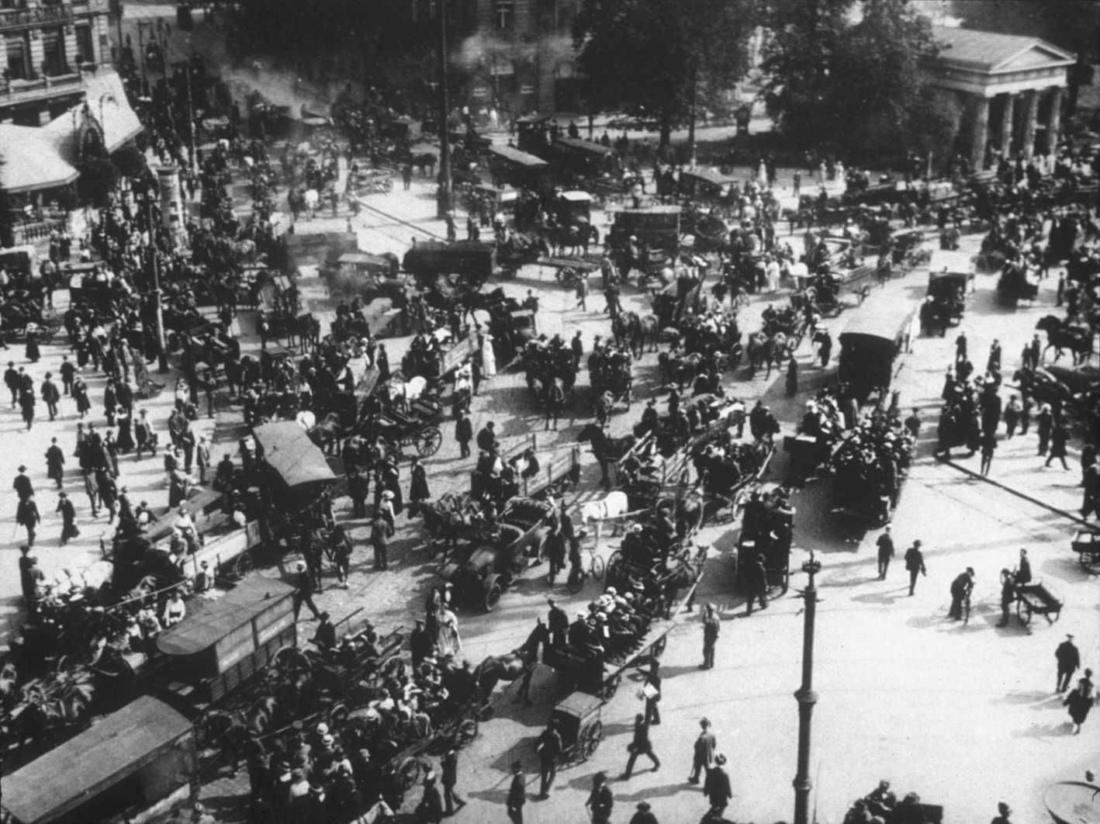
German Economy: Bank Collapse Begins
Austria’s Central Bank during Bank Run

Slide 26
Germany Government Spending
(in mill of Reichmarks)

Slide 27
German Gov’t Spending

Slide 28
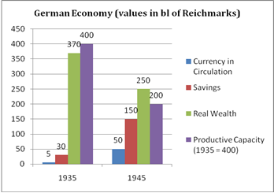
Economics and World War

Slide 29
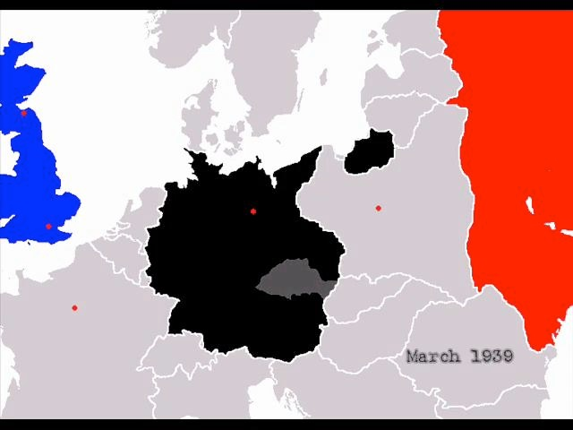
Why did Hitler strike in 1939? Because his economy was probably about to fall apart…
Notes:
Why did Hitler strike in 1939? Because his economy was probably about to fall apart…

