Slide 1
Nuclear Weapons

Slide 2
What are Nuclear Weapons
The United States developed and used the first Atomic Bomb during WWII. We dropped two atomic bombs on Japan hoping to force Japanese surrender.
The Canadian government and United Kingdom were involved in the Manhattan project.
Since WWII, countries have developed more powerful weapons (Hydrogen Bomb) that would cause far greater destruction.
Some studies have estimated that around 12 nuclear detonations would make the world uninhabitable.

Slide 3
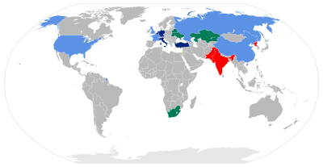
Nuclear Armed Countries
The United States, Great Britain, France China, Russia, India, North Korea, Pakistan, Israel

Slide 4
Have we tried to stop countries from obtaining Nuclear Weapons in the Past?
1970 Nuclear Non-Proliferation Treaty
Countries that agree to the deal can not develop nuclear weapons
By 1995 191 countries have signed the deal
India, Israel, North Korea, Pakistan, and South Sudan have not signed the deal
The United Nations has imposed heavy economic sanctions on countries trying to develop nuclear weapons

Slide 5
Two greatest threats
North Korea: currently have nuclear warheads. They have been working to develop missile systems
Iran: Do not have nuclear weapons, but have been working to expand their programs and develop weapons.

Slide 6
Possible Strategies
Economic sanctions in conjunction with the United Nations
Nuclear deals
Covert military action
Military Action

Slide 7
https://www.youtube.com/watch?v=3_hOIT-Wuxg
https://www.theguardian.com/world/live/2018/jun/12/trump-kim-summit-meeting-singapore-us-president-north-korea-kim-jong-un-

