Slide 1
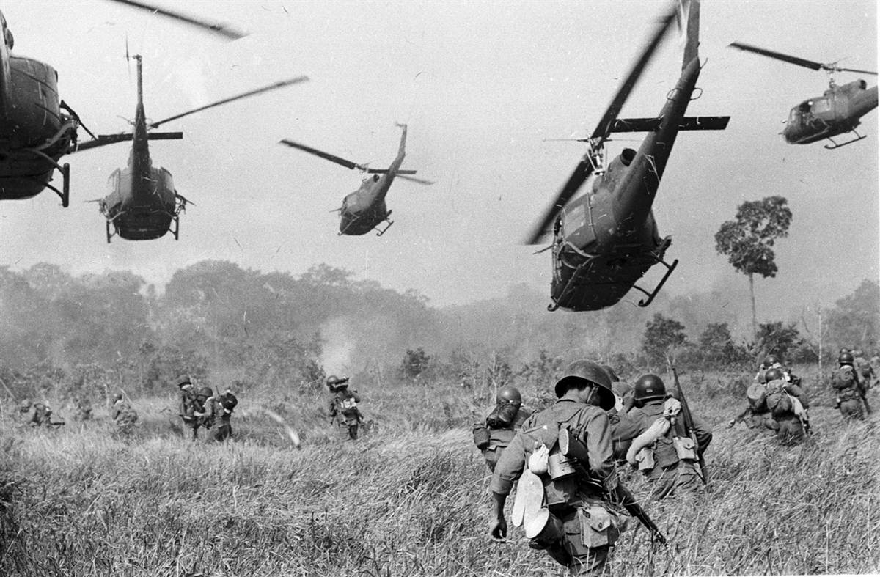
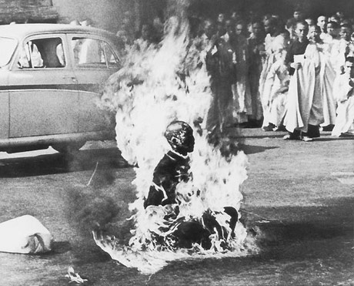
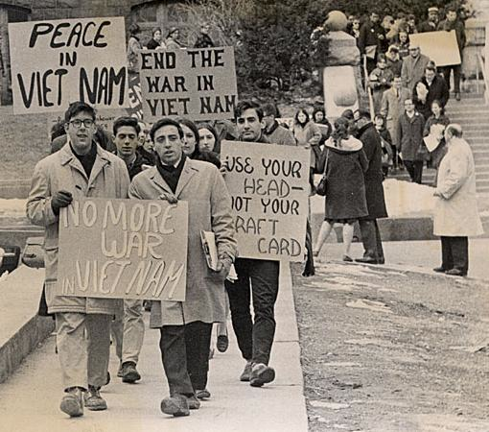
Vietnam War

Slide 2
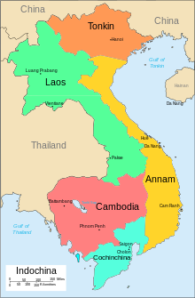
French Colonialism
France won control of Vietnam from China in 1885 and forms French Indochina
During WWII Japan seizes control of much of French Indochina
French educated Ho Chi Mihn fights against the French and declares independence and the Democratic Republic of Vietnam
1954 France surrenders control of the North to Ho Chi Mihn
The United States supports the democratic government in the South led by Diem

Slide 3
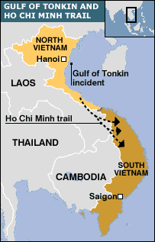
Gulf of Tonkin Resolution
Naval conflict between American and Vietnamese forces on August 2, 1964
"expressing the unity and determination of the United States in supporting freedom and in protecting peace in southeast Asia”
Congress passes the War Powers Act to limit the military power of the President in 1973 (Nixon Administration)

Slide 4
My Lai Massacre
March 16, 1968
Suspected Viet Cong forces hiding in local villages
Between hundreds of unarmed civilians killed
Impacted the U.S. civilian perception of the war

Slide 5
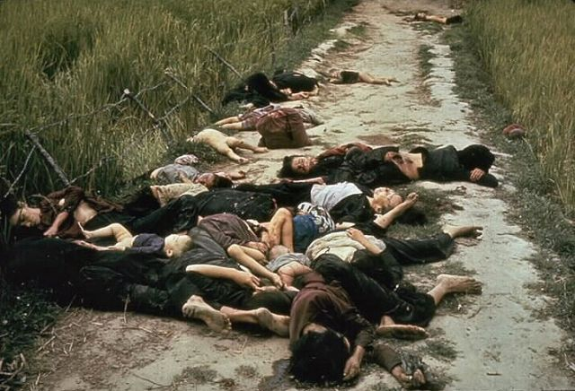
My Lai Massacre

Slide 6
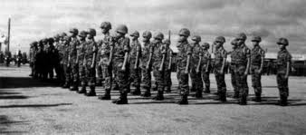
Vietnamization
Nixon administration
End the United States involvement in the war and expand and equip the South Vietnamese forces.
Differs from containment policy
Influenced by the Tet Offensive and decreasing support of the War in Vietnam by U.S. citizens

Slide 7
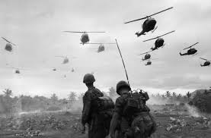
Timeline
1945- Ho Chi Minh creates provisional government.
1954- Eisenhower discusses “Domino Theory”
1960- Kennedy elected President. U.S. continues to support the Diem led South Vietnamese government
1963- President Kennedy assassinated. Lyndon Johnson assumes role as Commander in Chief.
1964- President Johnson issues Golf of Tonkin Resolution
1968- North Vietnamese (Viet Cong) launch Tet Offensive.
1969- Nixon implements Vietnamization policies.
1969- My Lai Massacre becomes public (Anti-war demonstration)
1974- Nixon resigns
1975- Ford withdraws last remaining U.S. troops
1975- Saigon (Southern capital) falls to the Communist North Vietnamese

